Slide 1

Confinement-Induced Resonances in a Quasi 1+0 Dimensional System
Peng Zhang
Department of Physics, Renmin University of China
中国人民大学物理系
（2018-04-10，中科院武汉物数所）
“textbook”: Ren Zhang and Peng Zhang, submitted to arXiv today
Notes:
Thank you xiong jun. good afternoon every one. It is my great pleasure to give a seminar talk in pku. The title of my today’s talk is Center-of-mass…. This work is done by me and my student jianwen jie. We have just submitted our mauscript in arxiv. In this work we propose that a new type of two-body interaction, which depends on the center of mass momentum of these two bodys, can be realized in ultracold atom gases.

Slide 2
Outline
Control of Spin-Exchange Interaction between Alkali-Earth Atoms
The problems and results of our work
Structure and interaction of alkali-earth (like) atoms
CIR in Quasi 1+0 D system
Detail of our calculations
Techniques can be generalized to other two-body problems (especially the systems in confinements)
Notes:
So in the beginning of my talk I will introduce what is the center-of-mass momentum dependent 2-body interaction.Since our proposal is based on the optical control of interaction between ultracold atoms, I will also give a brief review for the development of this technique. Then I will show the detail of our proposal, and illustrate our results with the example of the ultracold gases of two-component K40 atoms. Finally there is a summary.

Slide 3
Outline
Control of Spin-Exchange Interaction between Alkali-Earth (like) Atoms
The problems and results of our work
Structure and interaction of alkali-earth (like) atoms
CIR in Quasi 1+0 D system
Detail of our calculations
Techniques can be generalized to other two-body problems (especially the problems where the center-of-mass motion is coupled to relative motion)
Notes:
So in the beginning of my talk I will introduce what is the center-of-mass momentum dependent 2-body interaction.Since our proposal is based on the optical control of interaction between ultracold atoms, I will also give a brief review for the development of this technique. Then I will show the detail of our proposal, and illustrate our results with the example of the ultracold gases of two-component K40 atoms. Finally there is a summary.

Slide 4
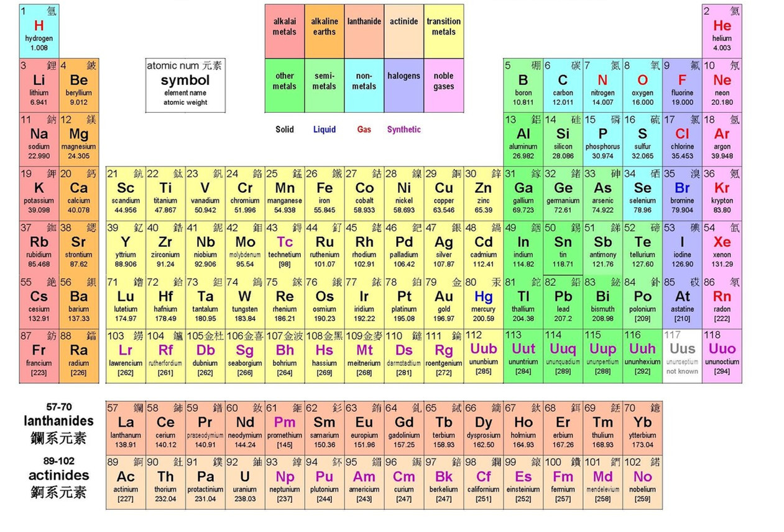
Ultracold alkali-earth (like) atoms

Slide 5

alkali-earth (like) atoms
Two outer-shell electrons
Long-lived electronic orbit state
Yb
Yb173: I=5/2
³P₀ (e)
~23s
¹S₀ (g)
ground state
m_{I}
Boson: I=0
Fermion: I$≠$0

Slide 6
Two-atom interaction
Our system:
³P₀ (e)
1 e-atom and 1 g-atom
(can be treated as distinguishable atoms)
¹S₀ (g)
⬆
nuclear spin
⬇
nuclear-spin states:
singlet state
triplet states

Slide 7
Two-atom interaction
2-body interaction in 3D space
Yb173 atoms:
spin-exchange interaction:
spin-exchange process:
can be used for the simulation of Kondo effect

Slide 8
Motivation and basic idea
Motivation:
Control of spin-exchange interaction
have similar energy:
B=0 or B is very small
no MFR has been discovered
In this work we assume B=0,
Basic idea:
confinement-induced resonance

Slide 9
Motivation and basic idea
System:
quasi-1D confinement which is same for both e-atom and g-atom
axial confinement only for e-atom
e
g
g-atom: flying Fermions (quasi-1D particle)
e-atom: localized spin-1/2 impurity (quasi-0D particle)
Control parameters:
characteristic lengths of the confinements

Slide 10
Motivation and basic idea
Exact Hamiltonian:
e
g
Free Hamiltonian:
transverse relative motion:
(2D oscillator)
axial motion of e-atom:
(1D oscillator)

Slide 11
Motivation and basic idea
g
e
Low-energy effective model
z
g-atom: flying pure-1D spin-1/2 Fermion
e-atom: spin fixed at z=0 (pure-0D)
z=0
Degree of freedom: z-motion of g-atom & spin of the two atoms
: effective 1D interaction strength
Effective spin-exchange interaction strength
Question: how large are ?

Slide 12
Control of $g_{+/−}^{\left(eff\right)}$ via CIR
Exact model: quasi 1+0 D
Effective model: pure 1+0 D
g
e
e
z
g
z=0
same scattering amplitude
$g_{±}^{(eff)}$ is determined by the scattering amplitude of $H_{0}(a_{⊥},a_{z})+V_{±}$

Slide 13
Control of $g_{+/−}^{\left(eff\right)}$ via CIR
Exact model: quasi 1+0 D
Effective model: pure 1+0 D
g
e
e
z
g
z=0
same scattering amplitude
Effective 1D interaction can be controlled via confinements

Slide 14
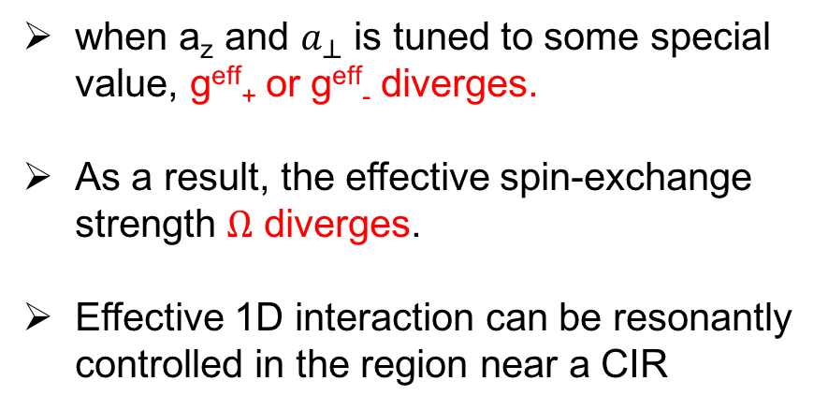
Control of $g_{+/−}^{\left(eff\right)}$ via CIR
Exact model: quasi 1+0 D
e
CIR:
g
when a_{z} and $a_{⊥}$ is tuned to some special value, g^{eff}₊ or g^{eff}₋ diverges.
As a result, the effective spin-exchange strength $Ω$ diverges.
Effective 1D interaction can be resonantly controlled in the region near a CIR
Effective model: pure 1+0 D
g
e
z
z=0
To investigate the CIR, it is necessary to calculate the scattering amplitude for the exact model H₀+V (“quasi-1D+quasi-0D problem”, difficult due to the coupling between center-of-mass and relative motion in z-direction)

Slide 15
Our previous works
“quasi-1D + quasi-1D” :
ignore the axial trap for e-atom
g
e
e
g
study the effect given by the quasi-1D tube
R. Zhang, D. Zhang, Y. Cheng, W. Chen, PZ and H. Zhai, PRA, 93, 043601 (2016).
“pure-1D + quasi-0D” :
g
e
z
ignore the transverse motion
focus on the effect given by the axial trap of the e-atom
Y. Cheng, R. Zhang, PZ, H. Zhai, PRA 96, 063605 (2017).
These results are fine for the cases where a_{z} and $a_{⊥}$ are quite different

Slide 16
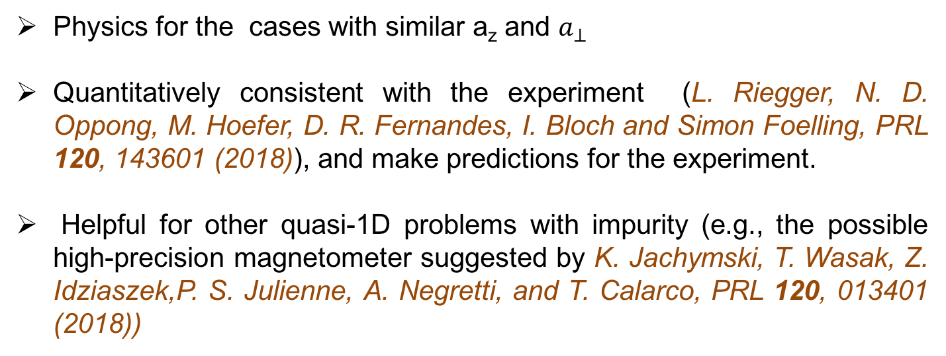
What we do?
We exactly solve the ”quasi-1D + qusi-0D” scattering problem between and derive g_{+/-}^{eff}
e
g
Physics for the cases with similar a_{z} and $a_{⊥}$
Quantitatively consistent with the experiment (L. Riegger, N. D. Oppong, M. Hoefer, D. R. Fernandes, I. Bloch and Simon Foelling, PRL 120, 143601 (2018)), and make predictions for the experiment.
Helpful for other quasi-1D problems with impurity (e.g., the possible high-precision magnetometer suggested by K. Jachymski, T. Wasak, Z. Idziaszek,P. S. Julienne, A. Negretti, and T. Calarco, PRL 120, 013401 (2018))

Slide 17
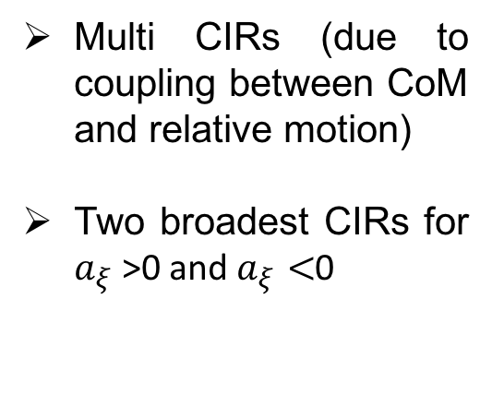
Our results: CIRs
e
g
Intensity of transverse confinement
“aspect ratio” of the trap of e-atom
Multi CIRs (due to coupling between CoM and relative motion)
Two broadest CIRs for $a_{ξ}$>0 and $a_{ξ}<$0

Slide 18
Our results: CIRs
Multiple CIRs
When $a_{z}/a_{⊥}$ is large, the CIRs can be realized in weaker confinements

Slide 19
Theory-Experiment Comparison
Theory vs Experiment
Optical-lattice induced trapping potentials are approximated as harmonic potentials
Shallow lattice for g-atoms are ignored.
e
g
Control parameters:
Intensities of optical lattices
Exp: L. Riegger, N. D. Oppong, M. Hoefer, D. R. Fernandes, I. Bloch and Simon Foelling, PRL 120, 143601 (2018),

Slide 20
Theory-Experiment Comparison
Our theory: g₊^{eff}
Experimental result: spin-flipped atom number
Two-site approximated theory in the experimental paper
CIR branches (II) and (III) are clearly observe
Broad CIR branch (I) are possibly able to be realized

Slide 21
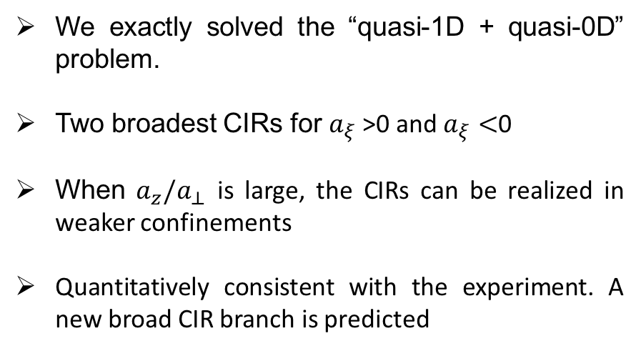
Summary
We exactly solved the “quasi-1D + quasi-0D” problem.
Two broadest CIRs for $a_{ξ}$>0 and $a_{ξ}<$0
When $a_{z}/a_{⊥}$ is large, the CIRs can be realized in weaker confinements
Quantitatively consistent with the experiment. A new broad CIR branch is predicted
e
g

Slide 22
Outline
Control of Spin-Exchange Interaction between Alkali-Earth Atoms
The problems and results of our work
Structure and interaction of alkali-earth (like) atoms
CIR in Quasi 1+0 D system
Detail of our calculations
Techniques can be generalized to other two-body problems (especially the systems in confinements)
We use the approach of P. Massignan and Y. Castin, PRA 74，013616 (2006) (pure-3D + quasi-0D)
Notes:
So in the beginning of my talk I will introduce what is the center-of-mass momentum dependent 2-body interaction.Since our proposal is based on the optical control of interaction between ultracold atoms, I will also give a brief review for the development of this technique. Then I will show the detail of our proposal, and illustrate our results with the example of the ultracold gases of two-component K40 atoms. Finally there is a summary.

Slide 23
Hamiltonian
Exact Hamiltonian:
e
g
Free Hamiltonian:
transverse relative motion:
(2D oscillator)
axial motion of e-atom:
(1D oscillator)

Slide 24

Eigen-state of H₀
e
transverse relative motion:
g
Independent of $n_{⊥ }$!
axial motion of e-atom:
eigen-state of H₀:
eigen-value of H₀:

Slide 25
Incident state wave function and Free Green’s function
incident wave function
e
g
scattering energy
low-energy condition
free-Green’s function

Slide 26
Lippman-Schwinger equation
e
Lippman-Schwinger equation
g
interaction
relative position

Slide 27
Lippman-Schwinger equation
Lippman-Schwinger equation
regularized wave function
In the following we will:
prove that the scattering amplitude is determined by the function
derive the integral equation for

Slide 28
Scattering Amplitude
free Green’s function

Slide 29
Scattering Amplitude
free Green’s function
e
g

Slide 30
Scattering Amplitude
Long-range wave function
e
g
Scattering amplitude: functional of $η_{ξ}(z)$

Slide 31
Integral equation for $η_{ξ}(z)$
re-writing Green’s function
Transfer the calculation of G_{E} to the calculation of G_{E’}

Slide 32
Integral equation for $η_{ξ}(z)$
Calculation of G_{E’}
Due to low-energy condition, E’<E₀
Laplacian transformation
Only converges when E‘<E₀

Slide 33
Integral equation for $η_{ξ}(z)$
Calculate of G_{E’}
imaginary-time propagator
2D oscillator
1D oscillator
1D free particle

Slide 34
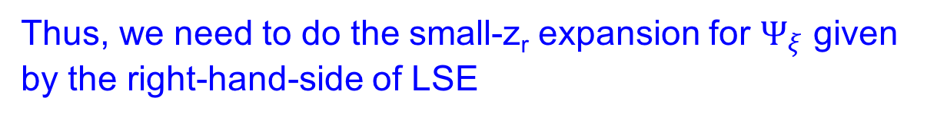
Integral equation for $η_{ξ}(z)$
definition of $η_{ξ}(z)$
Thus, we need to do the small-z_{r} expansion for $Ψ_{ξ}$ given by the right-hand-side of LSE
and extract the 0th order term

Slide 35
Integral equation for $η_{ξ}(z)$
If we have
Then the equation for $η_{ξ}(z)$ is
Now we calculate

Slide 36
Integral equation for $η_{ξ}(z)$
Difficulty:
When z_{r} is small, round the point z’=z we have
Thank Petrov!
As a result, the integration
does not uniformly converge at $z_{r}→0$

Slide 37
Integral equation for $η_{ξ}(z)$
as a result, when we calculate
We cannot exchange and

Slide 38
Integral equation for $η_{ξ}(z)$
To solve this problem, we first use previous results to re-express the LSE as
A
B
u
C
The terms A, B, C converges in the limit at $z_{r}→0$ . In this limit, we have
Now we do the expansion for u

Slide 39
Integral equation for $η_{ξ}(z)$
Now we do the expansion for U
Using the imaginary-time propagator we have
With

Slide 40
Integral equation for $η_{ξ}(z)$
Direct calculation gives
Furthermore, the integration
diverges in the limit
This divergence is due to the behavior of
in the limit

Slide 41
Integral equation for $η_{ξ}(z)$
Therefore, we re-express
as
with

Slide 42

Integral equation for $η_{ξ}(z)$
Thus,
Can be analytically calculated
converges at $z_{r}→0$

Slide 43

Integral equation for $η_{ξ}(z)$
Thus, in the limit $z_{r}→0$
with

Slide 44
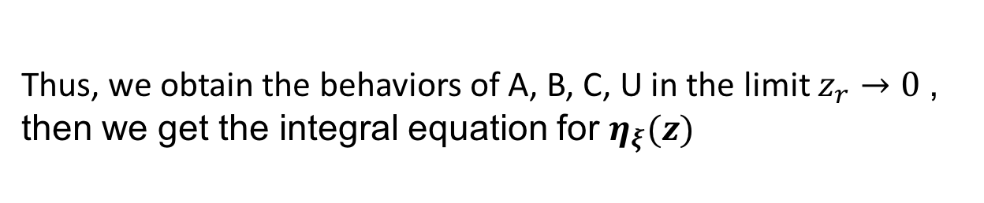
Integral equation for $η_{ξ}(z)$
Thus, we obtain the behaviors of A, B, C, U in the limit $z_{r}→0$, then we get the integral equation for $η_{ξ}(z)$
with

Slide 45
Integral equation for $η_{ξ}(z)$
where
We numerically calculate the kernels of the integral equation, and then numerically solve the integral equation, and calculate the scattering ampltiude.

Slide 46
Thank you!

Slide 47
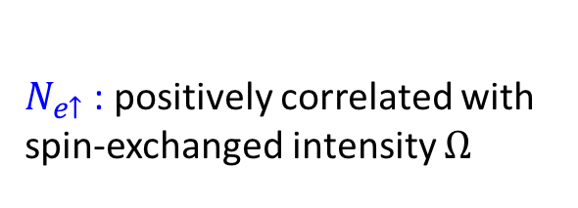
Theory-Experiment Comparison
$N_{e↑}$: positively correlated with spin-exchanged intensity $Ω$

