Slide 1
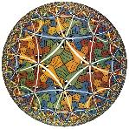
Self-assembling tensor networks and holography in disordered spin chains
A.M. Goldsborough, R.A. Roemer
Department of Physics and Centre for Scientific Computing
Thanks to EPSRC (EP/J003476/1)
A. M. Goldsborough, RAR, Phys. Rev. B 89, 214203-11 (2014)
“Leaf-to-leaf distances and their moments in finite and infinite m-ary tree graphs”, A.M. Goldsborough, S.A. Rautu, RAR, arXiv:1406.4079 , accepted in PRE
“Leaf-to-leaf distances in ordered Catalan tree graphs”, A.M. Goldsborough, J.M. Fellows, M. Bates, S.A. Rautu, G. Rowlands and RAR, arXiv: 1502.07893

Slide 2
Disordered Heisenberg chain
Paradigmatic model for interplay of disorder and many-body (spin-spin) interactions
Much is known already, both theoretically and numerically: ideal test case!

Slide 3
Disordered Heisenberg chain
Theoretical results: Ma, Dasgupta, Hu
  strong disorder real space RG (SDRG): successive elimination of neighboring spins with maximal coupling
  Universal power-law dependences for specific heat and susceptibility
[S. K. Ma, C. Dasgupta, and C. K. Hu, Phys. Rev. Lett. 43, 1434 (1979); C. Dasgupta and S. K. Ma, Phys. Rev. B 22, 1305 (1980)]

Slide 4

Disordered Heisenberg chain
Theoretical results: Fisher; Refael+Moore
  MDH ground state is “random singlet phase”
  Spin-spin correlation power-law
  Mean , not typical
  Entanglement
[D. S. Fisher, PRB 50, 3799 (1994); PRB 51, 6411 (1995); G. Refael and J. E. Moore, PRL 93, 260602 (2004)]

Slide 5
Disordered Heisenberg chain
Extended strategies: Westerberg et al.
  use (largest) energy gaps Δ
  works for spin beyond s=1/2
  universal for most P(J)
[E. Westerberg, A. Furusaki, M. Sigrist, and P. A. Lee, Phys. Rev. Lett. 75, 4302 (1995); Phys. Rev. B 55, 12578 (1997).]

Slide 6
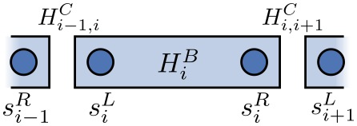

Disordered Heisenberg chain
Numerical strategies: Hikihara et al.
  higher multiplet excitations
  numerical verification of
keep more than ground state
[T. Hikihara, A. Furusaki, and M. Sigrist, Phys. Rev. B 60, 12116 (1999).]

Slide 7
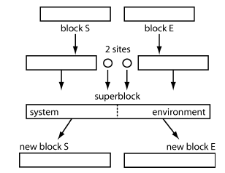
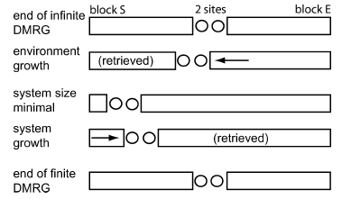
The gold standard: DMRG
Exponential growth of Hilbert space avoided by truncating using local information while keeping non-trival quantumness of states
Infinite and finite-system algorithms
[S. R. White, Phys. Rev. Lett. 69, 2863 (1992); U. Schollwöck, Ann. Phys. 326, 96 (2011).

Slide 8
MPS, MPO formulation of DMRG
DMRG builds up a matrix-product state
Physical indices (spin)
Tensor can be decomposed into tensor network.
[S. Ostlund and S. Rommer, Phys. Rev. Lett. 75, 3537 (1995); U. Schollwöck, Ann. Phys. 326, 96 (2011)]

Slide 9
MPS, MPO formulation of DMRG
Operators are written similarly for consistency
[S. Ostlund and S. Rommer, Phys. Rev. Lett. 75, 3537 (1995); U. Schollwöck, Ann. Phys. 326, 96 (2011)]

Slide 10
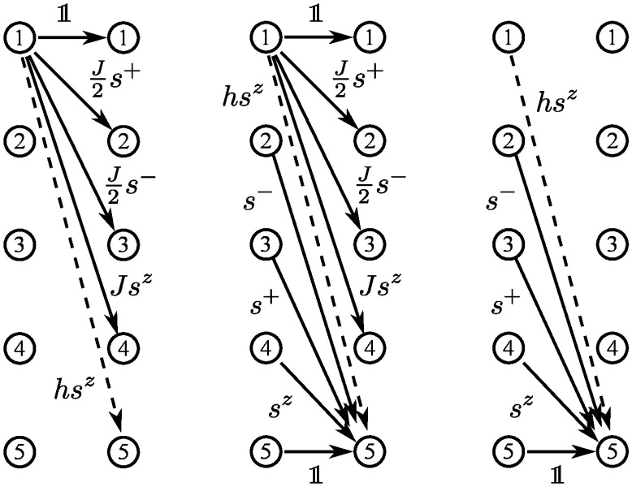
MPOs in practice - an example:

Slide 11
MPS, MPO formulation of DMRG
Moving to cartoons

Slide 12
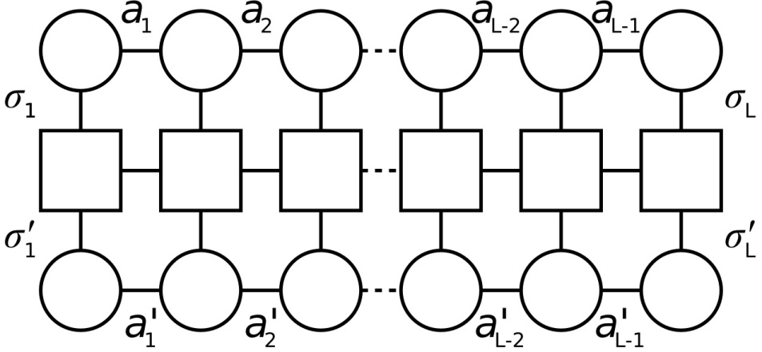
MPS, MPO formulation of DMRG
Moving to cartoons

Slide 13

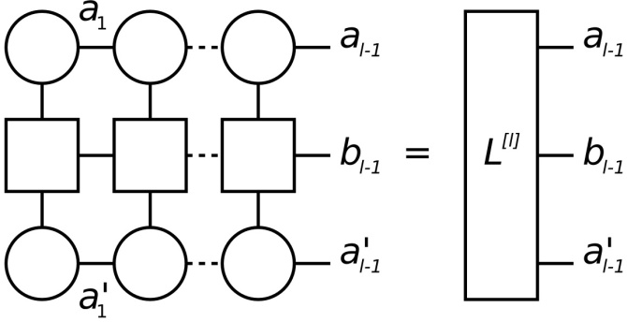
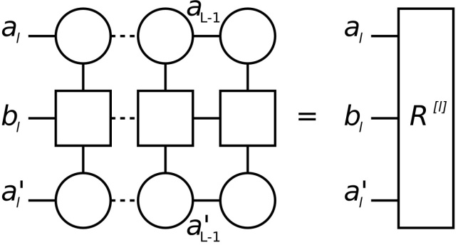
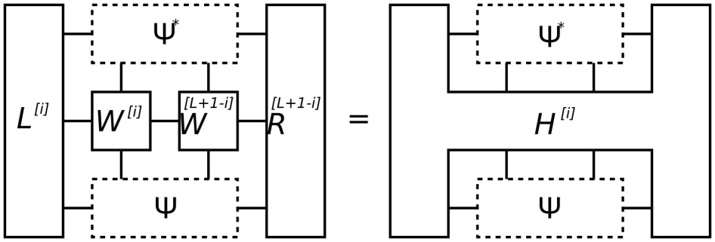
MPS, MPO formulation of DMRG
Reformulation of 2-site DMRG
Density matrix singular value-decomposed and truncated

Slide 14
SDRG MPO process
Contract MPO tensors for sites with largest gap
Keep lowest eigenvalues only and contract
A. M. Goldsborough, RAR, Phys. Rev. B 89, 214203-11 (2014)

Slide 15
SDRG MPO process
Contract MPO tensors for sites with largest gap
Keep lowest eigenvalues only and contract
A. M. Goldsborough, RAR, Phys. Rev. B 89, 214203-11 (2014)

Slide 16
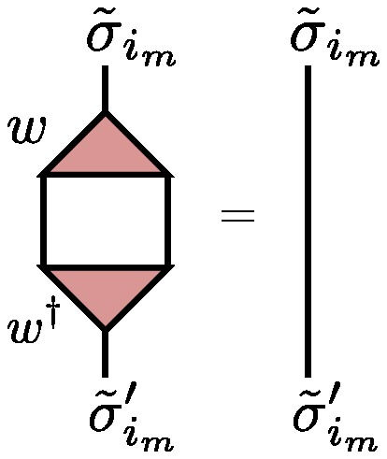
SDRG as TTN
Hilbert space
Basic RG step:
Isometry:

Slide 17
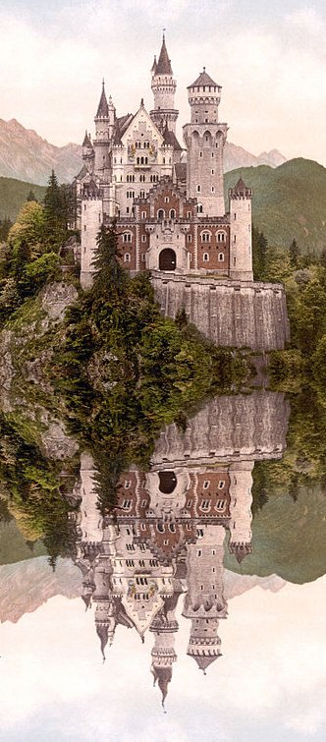
Tree tensor networks pictorially

Slide 18
Why bother?
vMPS works well for clean systems
vMPS ignores disorder in setup and hence update process is highly effected
Inhomogeneous TTN as presented here includes disorder as building block of network itself, ADAPTIVE
Hilbert space

Slide 19
Ground state convergence
DMRG=vMPS
SDRG with TTN=tSDRG
tSRDG converges
Energies a bit better in vMPS
Larger disorder improves tSDRG

Slide 20
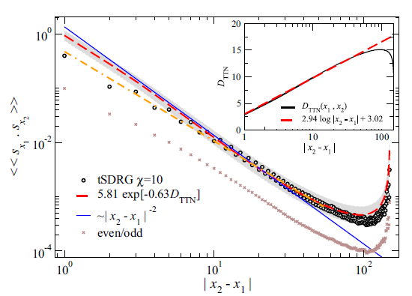
Spin-spin correlation
Fisher 1/r² recovered
Large distance behaviour dominated by boundaries

Slide 21
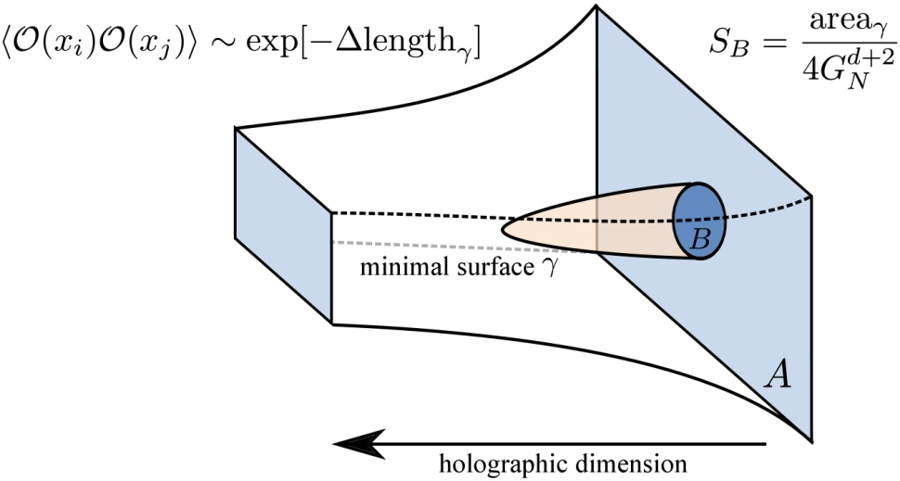

The idea of “holography”
Maldacena/Witten: physical world lives on surface of larger/bulk space
Swingle: tensor networks are like larger space
Evenbly/Vidal: might help in computing correlations
  Causal cone
[J. Maldacena, Int. J. Theor. Phys. 38, 1113 (1999); B. Swingle, Phys. Rev. D 86, 065007 (2012); J. Molina-Vilaplana, J. High Energ. Phys. 2013, 1 (2013); S. Ryu and T. Takayanagi, Phys. Rev. Lett. 96, 181602 (2006); J. McGreevy, Adv. High Energy Phys. 2010, 723105 (2010); G. Evenbly and G. Vidal, J. Stat. Phys. 145, 891 (2011)]
]

Slide 22
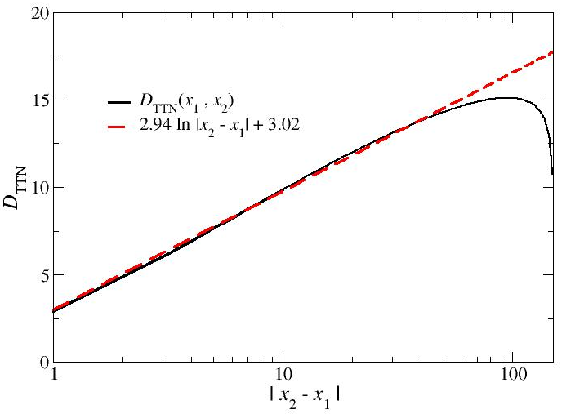
Fitting a path length
Proposal:

Slide 23
Spin-spin correlation as a holographic path length

Slide 24
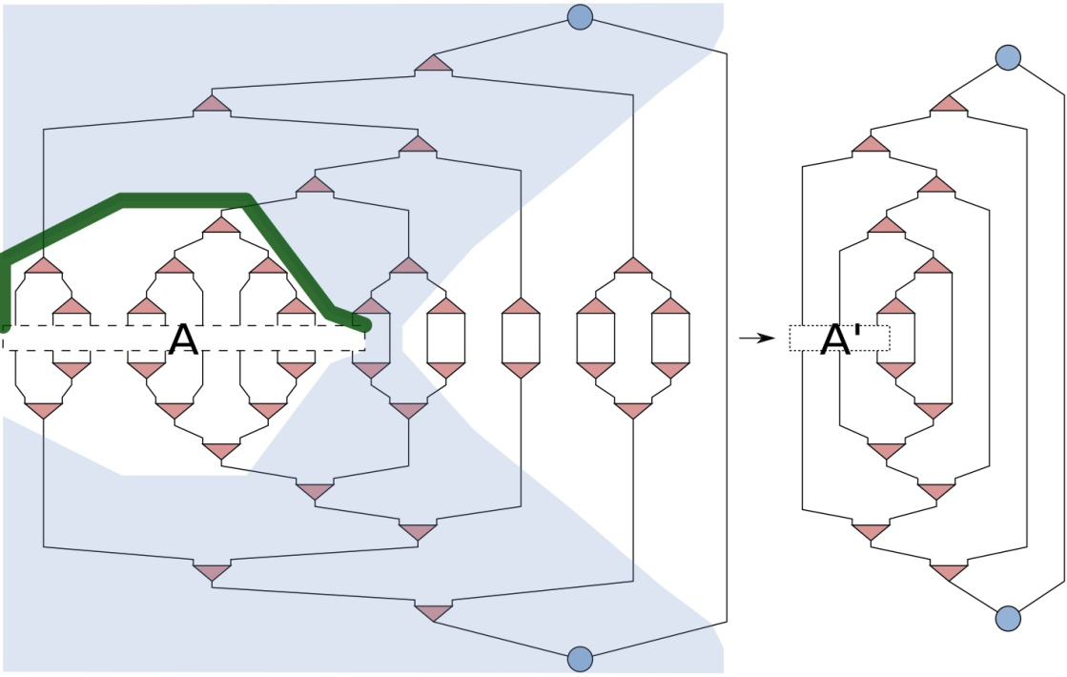
Entanglement entropy
Holography suggests new method of calculation:
minimum #bonds that need to be “cut” to separate A from B
Area law, see [Eisert et al, RMP 82, 277 (2010)]
[idea does not work in vMPS]

Slide 25
Entanglement entropy
Bipartite system
vMPS best for small ΔJ disorder
tSDRG better for ΔJ>1
Large difference between mean and maximum S

Slide 26
Log(L) increase for S_{A|B}
vMPS needs to increase
tSDRG does not, much easier to compute for large L
Large difference between mean and maximum S

Slide 27
Block entanglement S_{A,B}
Block(ed) system
[G. Refael and J. E. Moore, PRL 93, 260602 (2004)]
Refael/Moore result implies CFT with effective central charge
We find

Slide 28
Entanglement per bond, S/n_{A}
for and
we find constant ratio in bulk
implies

Slide 29
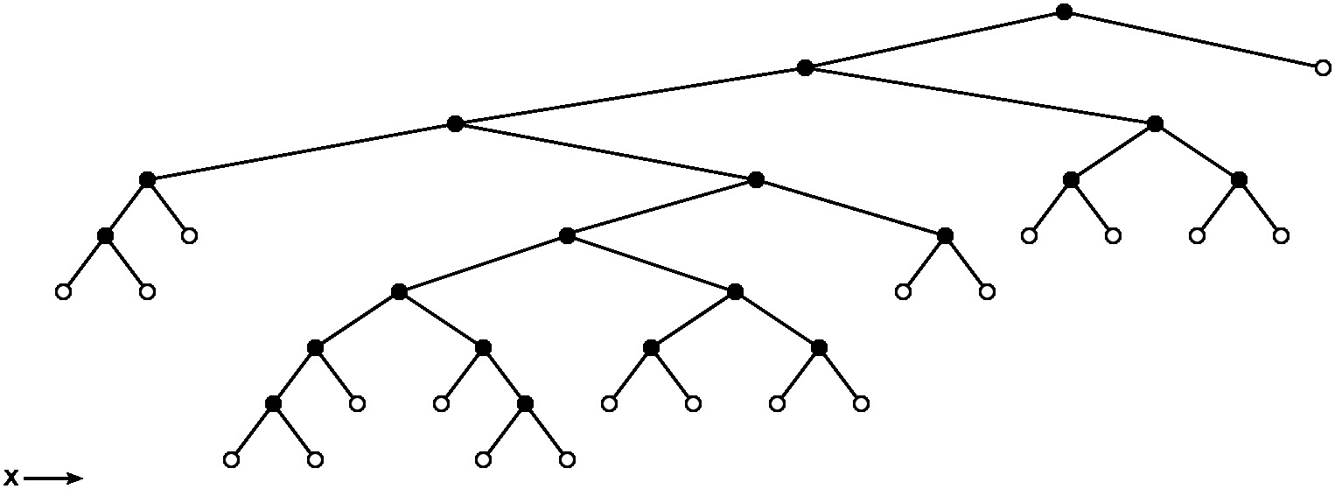
What about other tree tensor networks?
Can we perhaps compute the path lengths explicitely for some tree networks?

Slide 30
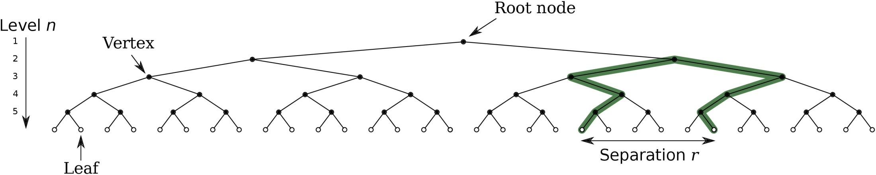
Path lengths in m-ary trees
Full and complete m-ary trees have been well studied, e.g. for sorting problems.
But 1D order imposes an apparently not yet studied condition.
“Leaf-to-leaf distances and their moments in finite and infinite m-ary tree graphs”, A.M. Goldsborough, S.A. Rautu, RAR, arXiv:1406.4079

Slide 31
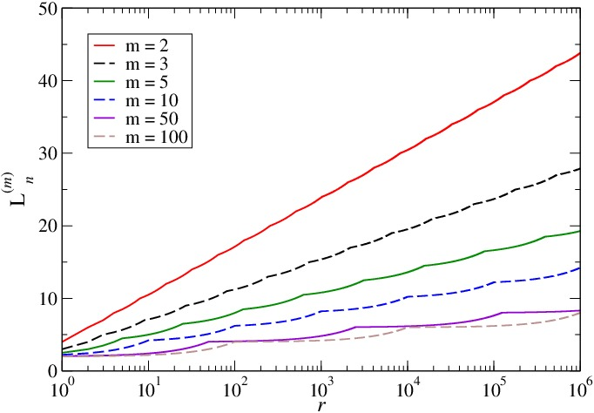
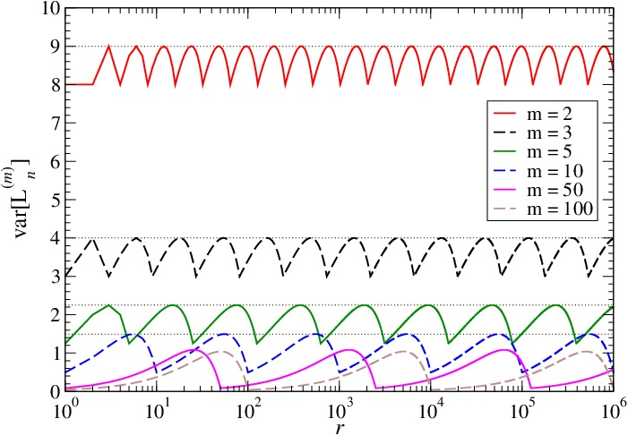
Path lengths in m-ary trees
We find
Hurwitz-Lerch transcendent
“Leaf-to-leaf distances and their moments in finite and infinite m-ary tree graphs”, A.M. Goldsborough, S.A. Rautu, RAR, arXiv:1406.4079

Slide 32
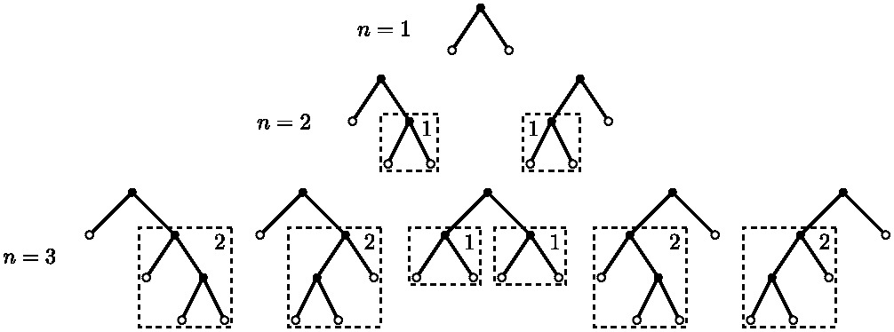
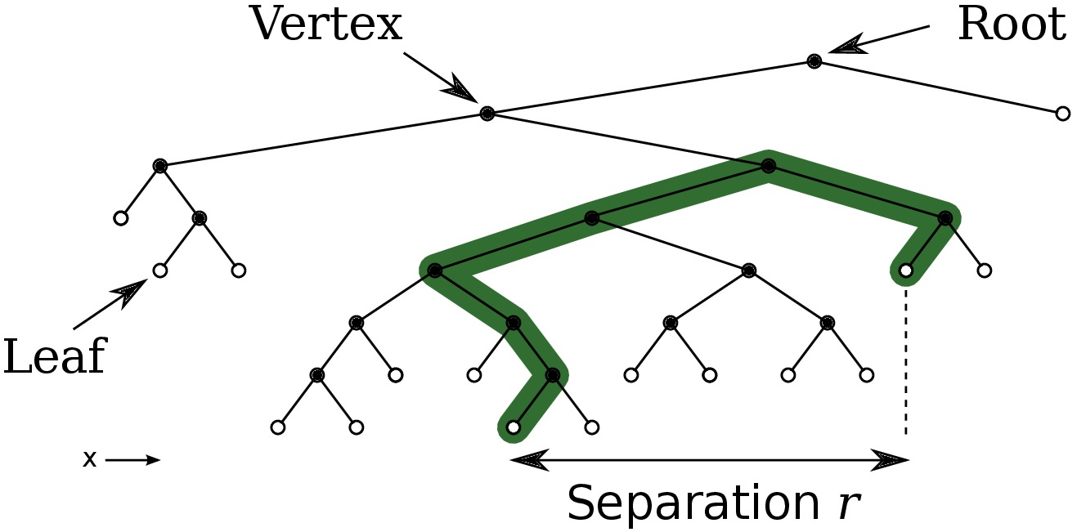
Path lengths in Catalan trees
Full, but not complete
Catalan numbers 1, 1, 2, 5, 14, ...
Not a random tree
“Leaf-to-leaf distances in ordered Catalan tree graphs”, A.M. Goldsborough, J.M. Fellows, M. Bates, S.A. Rautu, G. Rowlands and RAR, soon on arXiv

Slide 33
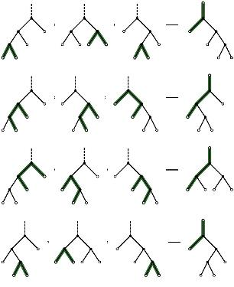
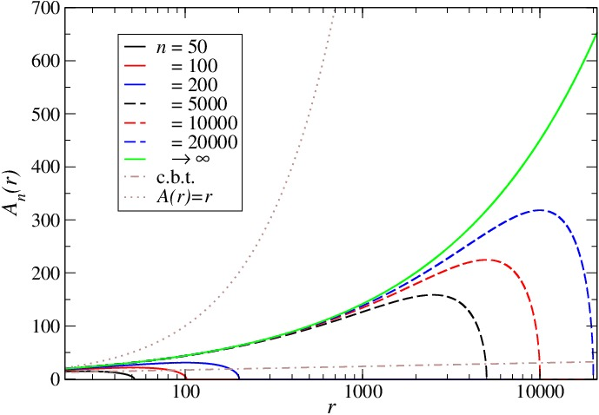
Path lengths in Catalan trees
We find
[P. Kirschenhofer, J. Combin. Inform. System Sci. 8, 44 (1983); P. Kirschenhofer, Ars Combin. 16A, 255 (1983); A. Panholzer and H. Prodinger, J. Stat. Plan. Inference 101, 267 (2002)]
“Leaf-to-leaf distances in ordered Catalan tree graphs”, A.M. Goldsborough, J.M. Fellows, M. Bates, S.A. Rautu, G. Rowlands and RAR, arXiv:1502.07893

Slide 34
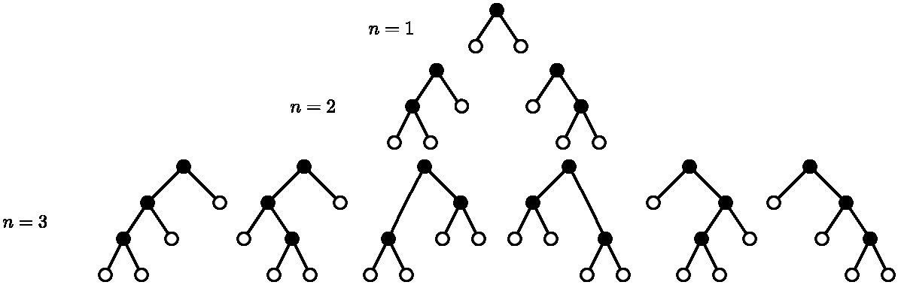
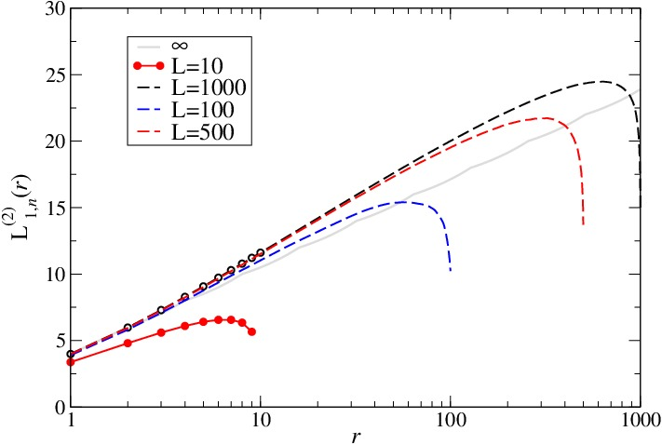
Random binary trees
not full, nor complete
n! possibilities
Computed for 500 samples of size L=10, 100, 500, 1000

Slide 35
The networks are different, so the physics will be as well ... (?)
tSDRG network
Full and complete m-ary trees
Catalan (complete binary) trees
Random binary (not full or complete)

Slide 36
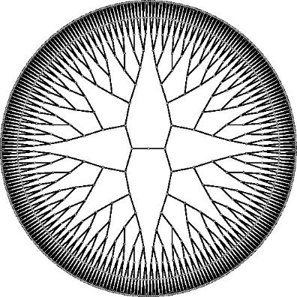
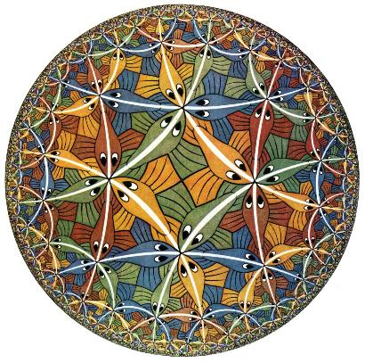
Periodic boundaries (binary)
Circle Limit III is a woodcut made in 1959 by Dutch artist M. C. Escher

Slide 37
Conclusions
An inhomogeneous, self-assembled TTN works. First such beast ever!
We compared vMPS with tSDRG; vtSDRG is possible and should be much better
(just as finite-size DMRG is better than infinite-size DMRG)
Holography holds in 1D disordered quantum spin chains, 1st quantitative check!
Explicit construction of path lengths for a variety of tree graphs: Fun with trees!
A. M. Goldsborough, RAR, Phys. Rev. B 89, 214203-11 (2014)

Slide 38
Isometries make computation faster

Slide 39
How to do the RG with a TTN

Slide 41


Slide 42


Slide 43

Notes:
Environment:
A more integrated, less stark landscape.
SU and Arts Centre developments – the Piazza as a cultural hub)
Landscape features.
Big campaign on Gibbet Hill.
Huge benefits after short term pain!

Slide 44


