Slide 1
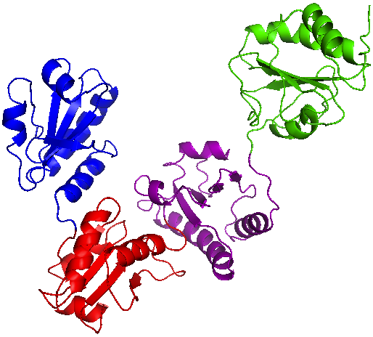
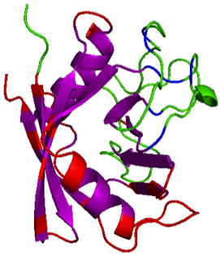
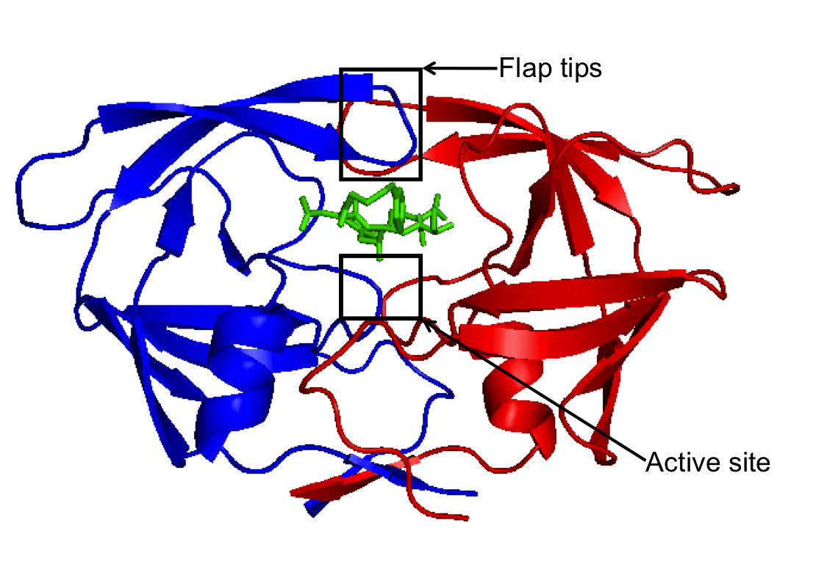
Dynamics and flexibility of proteins
Large domain motions, ligand binding and more
J Heal, E Jimenez, SA Wells, RB Freedman, RA Roemer
PDI
CypA-CsA
HIV-1 protease
Jimenez-Roldan et al., submitted to Biophysical Journal, (2013)
Heal et al., Bioinformatics 28 (3), 350-357 (2012)
Heal, et al., Biophys J. 108, 1739-1746 (2015)
Notes:
INTORDUCE THAT these are pictures of X-ray crystal structures. MENTION that my first study is entirely theoretical.
PROTOS is GREEK. Lego analogy. There are more than 100,000 different proteins in our bodies. They are represent about half of the dry matter in every cell and are of central importance to a broad range of indispensible biological process. They help cells communicate and transport other molecules as well as speeding up results. They ensure that DNA can replicate and also ensure that the instructions in the genetic code can be carried out. What is remarkable is that they are formed of 20 simple building blocks, called amino acids, or “residues”. These are like lego bricks, essentially the same but slighlty different in size and colour. As lego bricks can be used to build a diverse range of structures, so can amino acids be assembled in order to form a stunning range of functional protein molecules. Amino acids are linked together to form protein chain, known as the primary structure of the protein. How this long chain – a piece of string really – folds to form the structure of the protein is an ongoing concern in structural biology and has been for decades. The diversity of structures available ensure that this is a difficult problem. Levinthal’s paradox : random folding mean that for a protein to adopt the lowest energy state => would take billions of years. Actually, they fold in milliseconds.
Another issue. There is no single, final low energy folded shape for each protein. They are dynamic. Instead, they adopt a series of similar shapes alll of low energy and interconvert between them. It’s a bit like when you go to sleep you are in a low energy state, but you still may move on to your back for a bit, of on to your side, or maybe the other side. It is similar with protein structures. All these things: the sequence of amino acids, the low energy conformation, the ensemble of sleeping positions accessible from this position, impact on the function of the protein. How does the protein do its job. When OUR proteins can’t do their jobs properly, BAD THINGS happen. For example, CJD, BSE, Alzheimers.
However, in some cases, we wish to stop the protein from doing its job properly. This can happen when the protein is a BADDIE. A good example of this is one of the proteins I studied during my PhD, which is called HIV-1 protease.

Slide 2
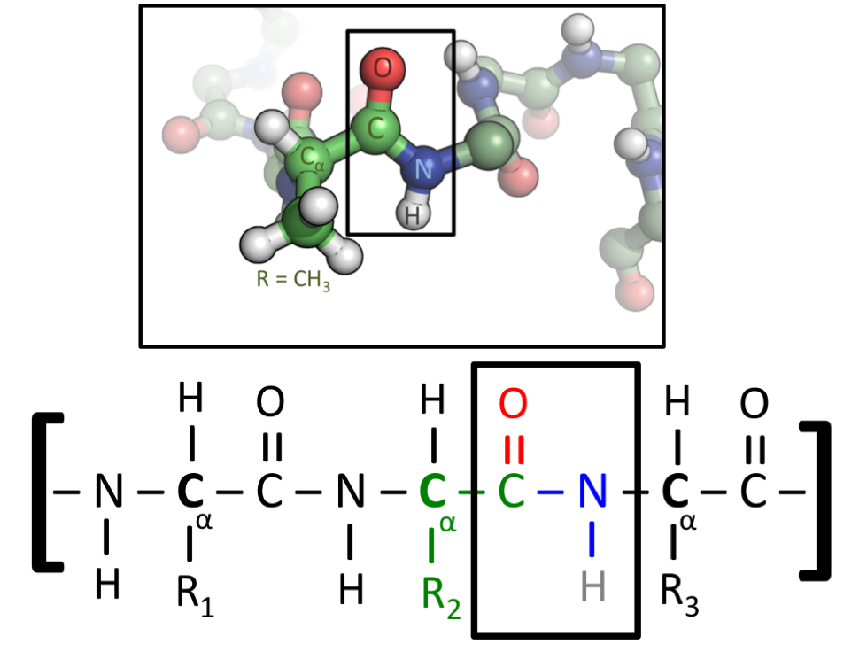
Proteins, the chemistry of life
Proteins are polymers of amino acids covalently linked through peptide bonds into a chain
There are 20 common amino acids: Alanine, Isoleucine, Leucine, M, F, P, W, V, N, C, Q, G, S, T, Y, R, H, K, D, E
[Wikipedia: “Protein” and “Protein structure”]

Slide 3
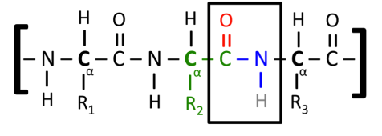
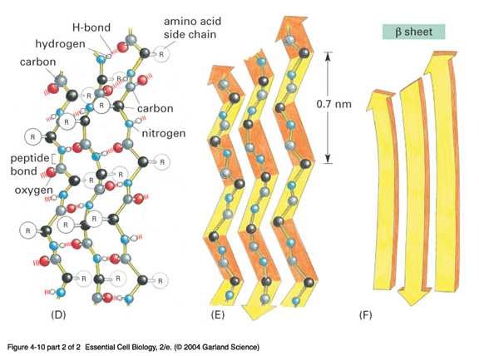
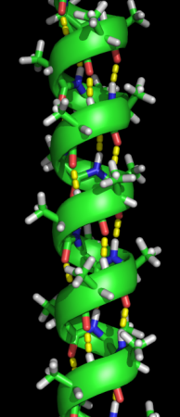
Proteins have structure
Primary structure: AGTACGTVWTAG...
Secondary structure:
highly regular local substructures,
α-helices & β-sheets
Tertiary structure:
α-helices & β-sheets folded into 3D superstructures, determines function
Quaternary structure:
domains, sub-units (dimer, trimer, ...)
[Wikipedia: “Protein” and “Protein structure”]

Slide 4
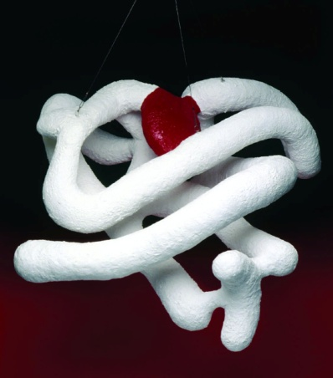
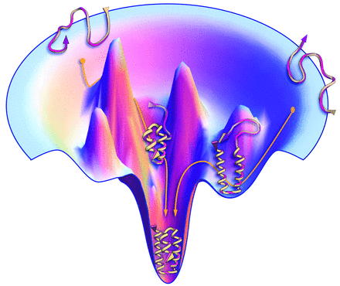
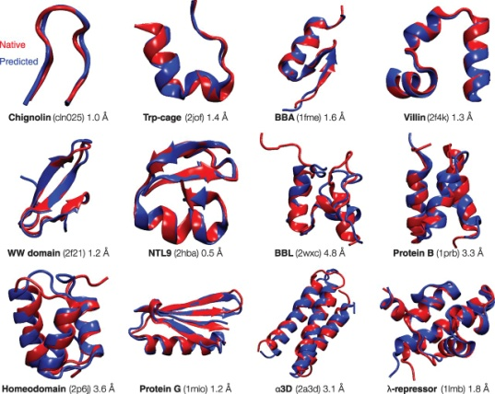

Protein folding problem/puzzle
Kendrew 1958
How to go from primary structure to tertiary/quaternary 3D fold?
How can it happen so fast?
Levinthal 1968: despite huge number of conformations accessible, protein can fold to its one precisely defined native structure in microseconds (for some proteins). How does the protein “know” what conformations not to search?
Can we write computer code to predict the structure from the sequence? Small ones ...
The Protein-Folding Problem, 50 Years On
Science 23 November 2012:
vol. 338 no. 6110 1042-1046

Slide 5
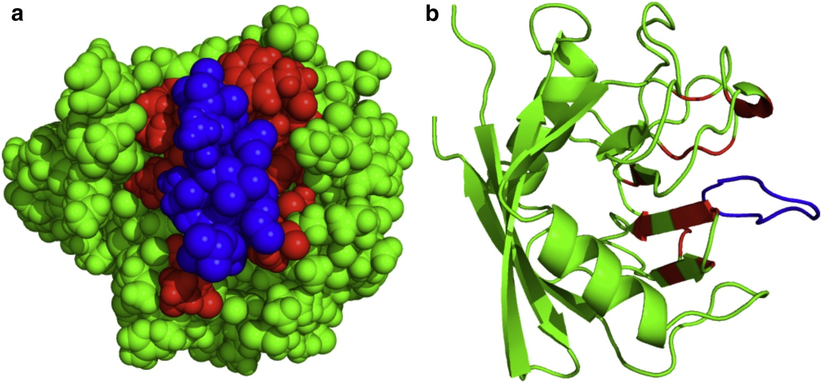
Beware of schematics/cartoons
Two representations of the same protein:

Slide 6
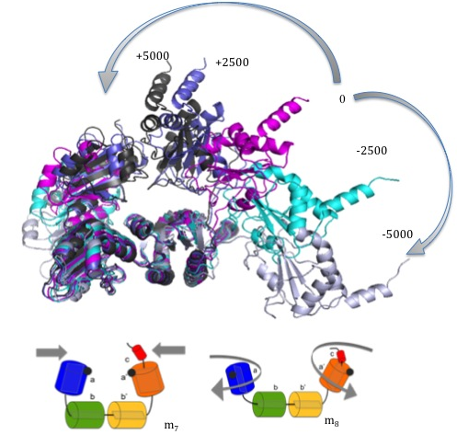
Dynamics and flexibility of PDI
Large domain motions and more
RA Roemer +
E Jimenez, M Bhattacharyya, SA Wells, S Vishweshwara, RB Freedman
PDI = protein disulphide-isomerase, a folding catalyst in endoplasmic reticulum
[Jimenez-Roldan, J. E., et al., Phys Biol 9, 016008 (2012)
Jimenez-Roldan, et al., "The dynamics and flexibility of protein disulphide-isomerase (PDI): predictions of experimentally-observed domain motions”. submitted to Biophysical Journal, (2013)]

Slide 7
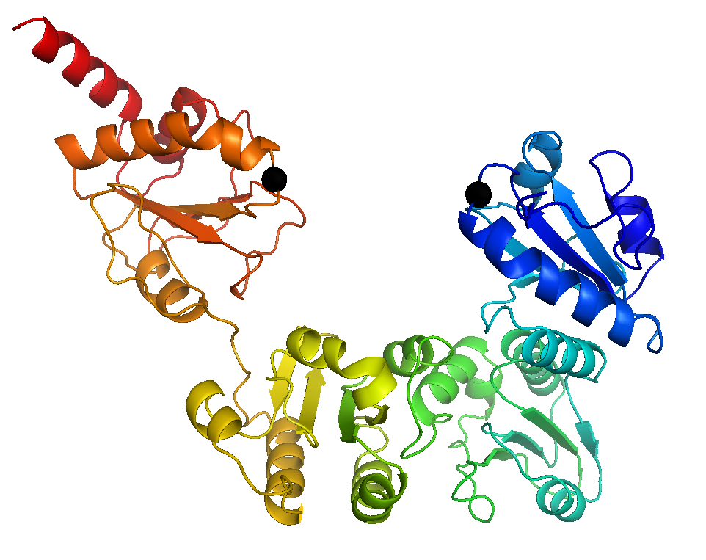
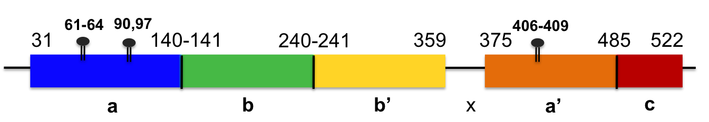
Yeast PDI
[Tian, G., et al., Cell 124, 61–73 (2006).
active sites
2B5E in PDB since 2006, 522 residues
3B0A in 2008
4 domains abb’a’, x-linker, c-terminal
flexibility underlies its function
Human PDI in 2012

Slide 8
Three questions for PDI
yPDI can be crystallised in two conformations, high resolution x-ray structures show difference in the relative orientation of a and b domains.
Q1: why these two different structures, can they be interlinked, e.g. by domain motion.
PDI data (mainly spectroscopic) indicates inter-domain flexibility (b’-x-a’), where the x-linker can mediate alternative orientations of the b’ and a’ domains.
Q2: what is quantitative extent of flexibility, i.e. distances and angle variations?
Chemical cross-linking data (1991) suggests that active sites in the a and a’ domains can approach more closely than is suggested by the crystal structures.
Q3: what is a quantitative prediction on the range of active site distance (testable in experiments)?
Aim: to provide quantitative evidence of flexibility of PDI both inter- and intradomain.

Slide 9
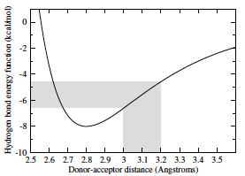
Flexibility via rigidity
[Thorpe, et al., J. Mol. Graph. Model 60–69 (2001)]
A
FIRST:
  Use PDB
  no quantum
  network of bonds
  bonds (H) open or closed
B
1
2
1
2
3
4
5
A
E_{cut}
B
3
4
C
5

Slide 10
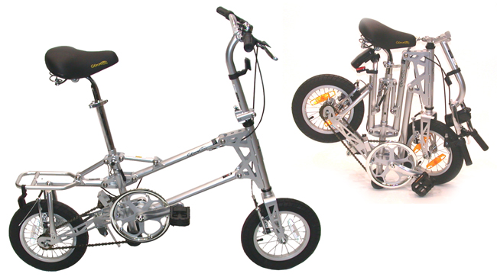
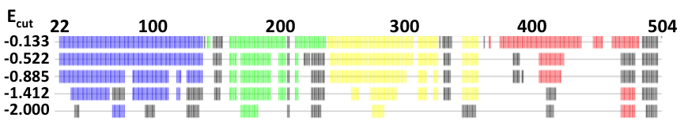
Rigidity of yPDI
4 domains a-b-b’-a’ emerge including x-linker and c-terminal
idea: coarse-grain by keeping rigid domains rigid!

Slide 11
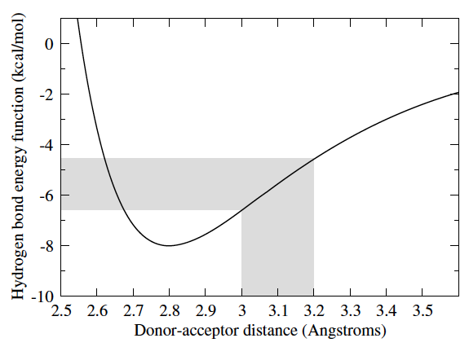
The meaning of E_{cut}
E_{cut} measures H-bond energy
Lower E_{cut} leads to bonds with shorter distances closed, bonds over larger distances open up

Slide 12
Normal mode analysis
[Suhre, et al., Acta Cryst D 60, 796–799 (2004)]
all-atom elastic network model can reproduce the shape of the low-frequency part of the density of states
assume equal springs
compute normal modes, i.e. directions of possible movement
lowest frequency modes most important
(but not modes 1-6, just translation and rotations in 3D)
Suhre, K. & Sanejouand, Y.-H. ElNemo: a normal mode web server for protein movement analysis and the generation of templates for molecular replacement. Nucleic Acids Research 32, W610–W614 (2004).

Slide 13
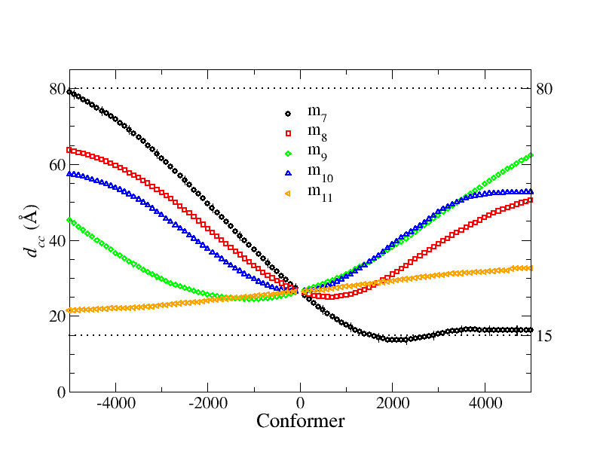
FRODA: moving around
[Wells, S., Menor, S., Hespenheide, B. & Thorpe, M. F. Constrained geometric simulation of diffusive motion in proteins. Phys Biol 2, S127–S136 (2005)]
FRODA: uses NMA input and then
moves small step along direction of normal mode m
avoids steric clashes
gives picture where movement might lead to
PDI: 2B5E lowest modes
Cys(61)-Cys(406)
opening
closing

Slide 14
Flexibility approach
flex

Slide 15
FIRST+ElNemo+FRODA [hours]
flex
Cys(61)-Cys(406)
range of possible movement
opening
closing
minimal distance!

Slide 16
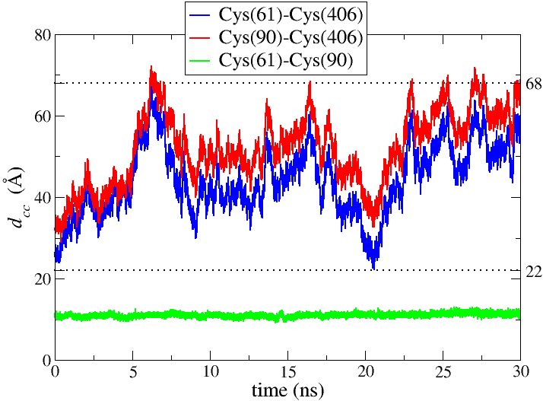
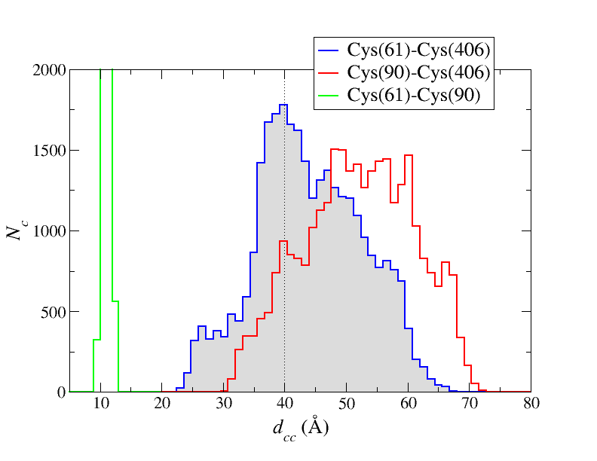
Molecular Dynamics [weeks]
MD
Consistent, but no minimal distance of 15A
15A
3 months
30ns all-atom MD at 300K, Amber9, implicit water, yPDI neutralized with Na+, ...

Slide 17
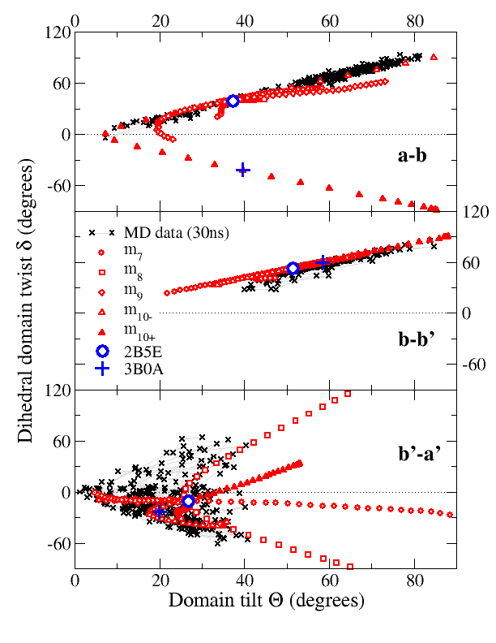
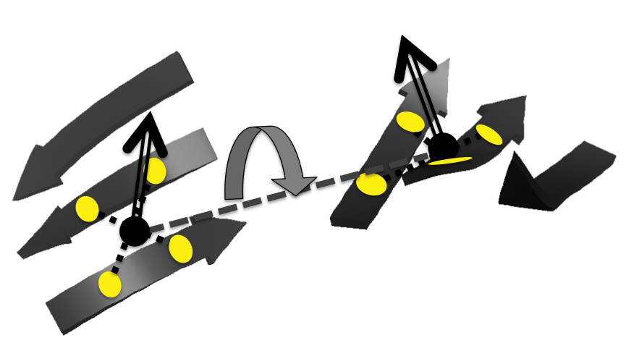
Interdomain motion: tilt and twist
stability of β-sheets on b and b’ domain used to “anchor” normals vectors
relative dihedral twist and tilt can be used to quantive interdomain motion
3B0A can be made via tilt/twist motion from 2B5E using flex
flex+MD

Slide 18
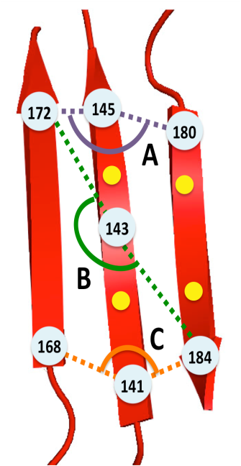
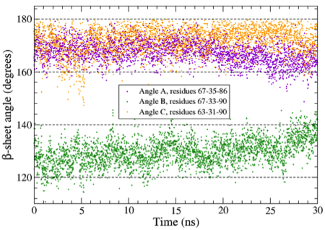
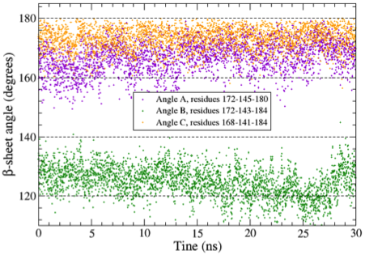
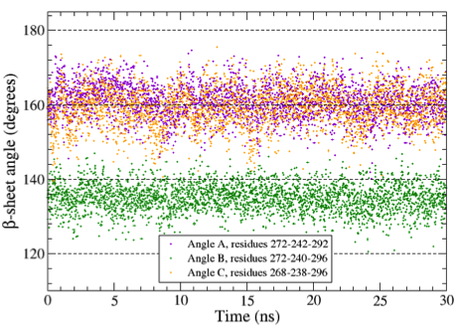
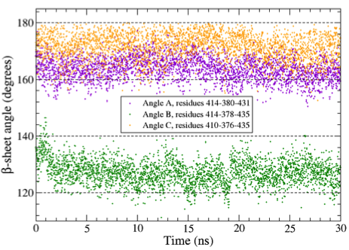
Stability of β-sheets [MD]
a
b
b’
a’
MD

Slide 19
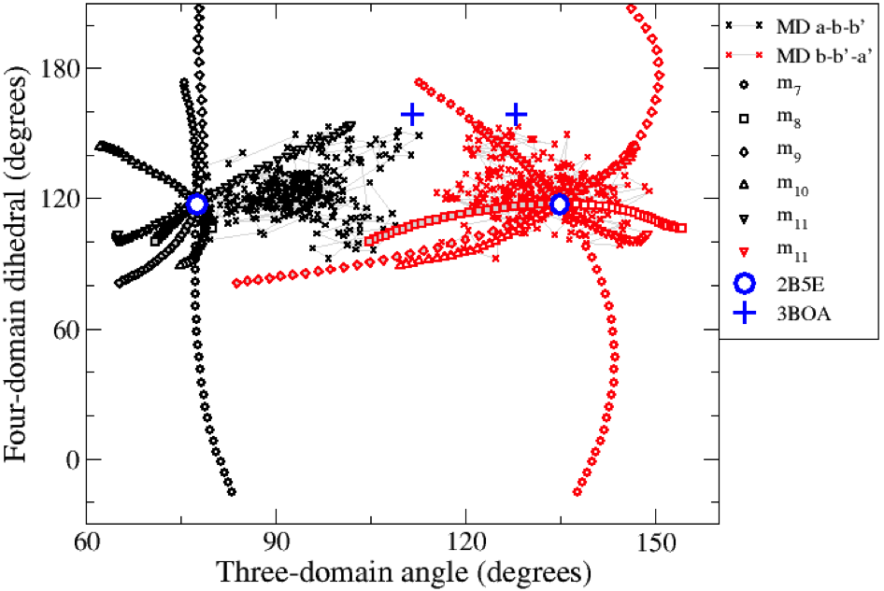
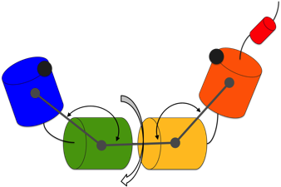
4-barrel motion
as expected, flex results show larger range than just MD
note that 3B0A seems well captured by flex
flex+MD

Slide 20
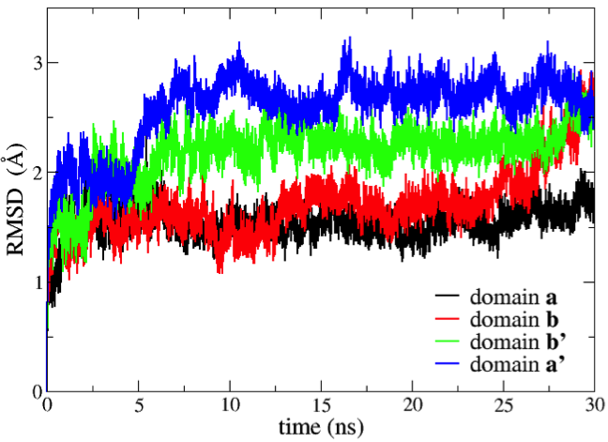
Intradomain motion
domain a’ has largest internal motion
consistent with experiments and rigidity
MD
a
b
b’
a’

Slide 21
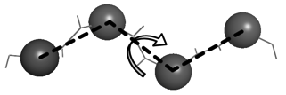
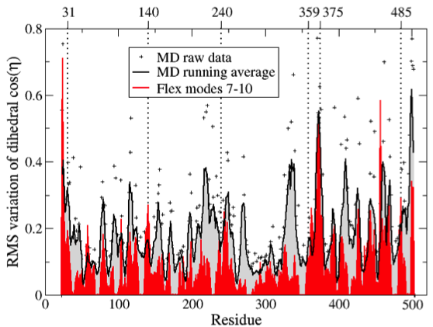
Intradomain: dihedral along protein
variation of dihedral angle during “motion” gives local measure of flexibility
MD and flex roughly agree
a’ seems more flexible
a
b
b’
a’
flex+MD

Slide 22
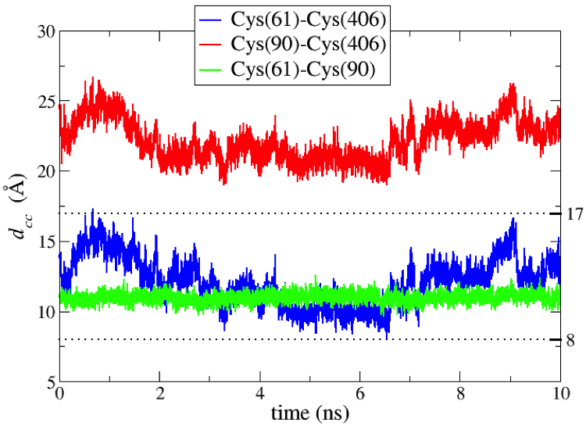
MD stability of closed yPDI
use the closed structure of 2B5E as start structure for MD
Q: will it be unphysical and hence “explode”?
A: no, see graph
flex
MD
flex as quick tool to prototype structures

Slide 23

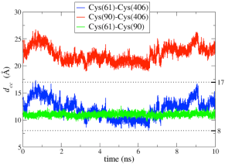
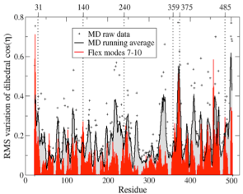
Conclusions (for yPDI)
There is inter-domain flexibility at every inter-domain junction showing very different characteristics – extensive freedom to tilt and twist at b’-a’, constrained to a specific twist mode at a-b, and with no freedom to twist at b-b’.
Two active sites can approach much more closely than is found in crystal structures – and indeed hinge motion to bring these sites into proximity is the lowest energy normal mode of motion of the protein.
Flexibility predicted for yPDI (based on one structure) includes the other known conformation of yPDI and is consistent with the mobility observed experimentally for mammalian PDI.
There is also intra-domain flexibility and clear differences between the domains in their propensity for internal motion.

Slide 24
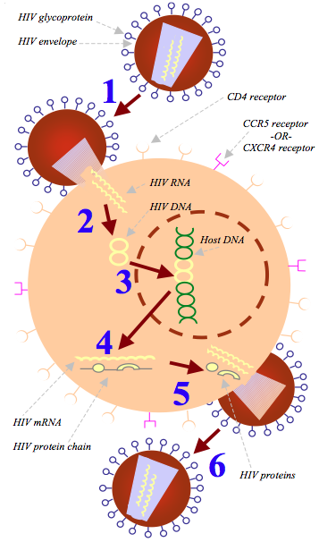
HIV-1 Lifecycle
1. Fusion
Rigidity analysis: FIRST
2. Reverse Transcriptase
3. Integrase
4. Transcription
HIV-1 protease
5. Protease
6. Budding
http://www.thebody.com/content/art53763.html
Notes:
Acquired Immunodeficiency Syndrome.
Acquired after infection with Human Immunodeficiency Virus.
HIV kills helper T-cells.
HIV gestation period: ~ 10 years.
After AIDS symptoms, usually less than a year to death.
Reverse transcriptase, integrase, protease.

Slide 25
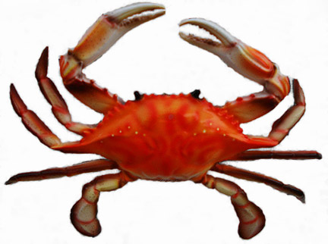

The structure of HIV-1 protease
symmetrical homodimer, each containing 99 residues
Flaps
Active site
Heal et al., Bioinformatics 28 (3), 350-357 (2012)
Notes:
KEY points: symmetrical homodimer, flap move to allow access to Active site, which does the chopping.

Slide 26
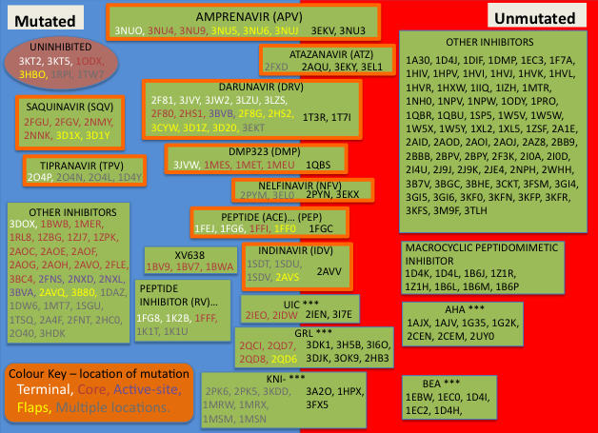
Lots of different crabs
Notes:
MD !!!!!!!
EMPHasise that there is a massive number of crytsal structures – lots of data to be tapped into. Can we do a broad study of this information from a desk and get something (potentially) useful out of it?Emphasise that each code here is a crystal structrue with a ligand bound.
High resolution structures of HIV-1 protease available in the PDB.
Many mutated, many wild type. All sorts of different mutations.
Groups of inhibitors together.
The boxes with an orange border are the ones of our “main inhibitors” – there are 7 of the 9(10) FDA approved inhibitors here.

Slide 27
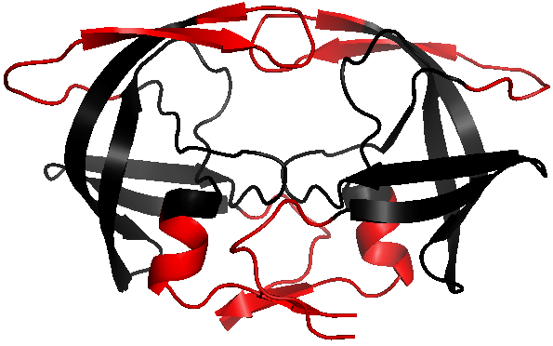
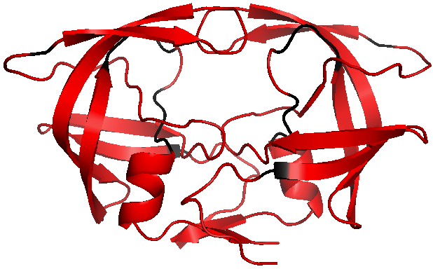
Rigidity analysis: FIRST
The bond network determines the rigidity of the protein.
We open bonds sequentially according to strength.
Black = rigid. Red = flexible
Notes:
Bond strength is determined using the geometry (distance and angle) given by the crystal structure.
Talk about Ecut as being the position of the arrow on this plot. The parameter E_{cut} is used to determine the bond network.
All bonds whose strength lies below E_{cut} are included. Gradually lower E_{cut} and re-perform rigidity analysis each time.
As E_{cut} is lowered, the number of bonds in the network is reduced.
Rigidity decreases as a consequnce.
NEED TO SAY: FIRST allows you to study large protein structures, or large numbers of protein structures on the order of seconds on a desktop computer.

Slide 28
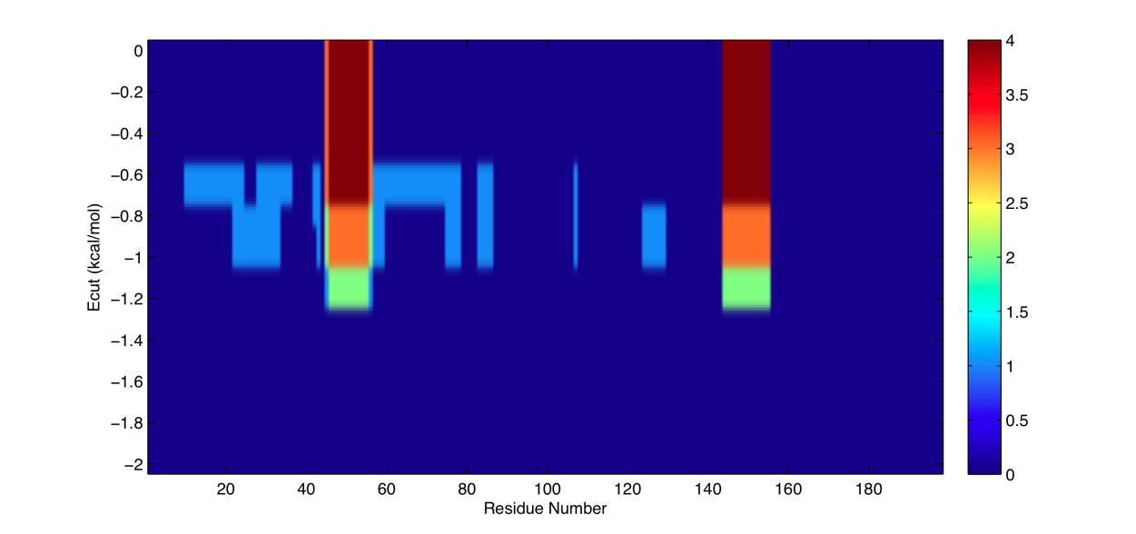
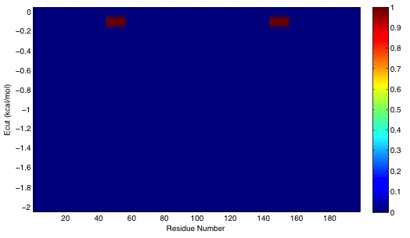
Rigidity difference maps
The two types of inhibitor are particularly effective in combination.
Hicks et al., The Lancet, (2006), 368 (9534), 466–475.
Our study was used by researchers at Novartis predicting binding energies.
Greenidge et al., J. Chem. Inf. Model, (2012), 53 (1), 201-209.
Heal et al. Bioinformatics, (2012), 28 (3), 350-357.
Tipranavir
Need heatmap for DRV
Amprenavir

Slide 29
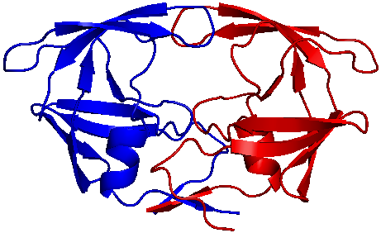


Rigidity Analysis of HIV-1 Protease
HIV-1 protease cuts replicated HIV virus into individual copies
stopping this is part of HIV therapy
ligands can do it two ways
combination therapy
[Heal, J. W., Jimenez-Roldan, J. E., Wells, S. A., Freedman, R. B. & Römer, R. A. Inhibition of HIV-1 protease: the rigidity perspective. Bioinformatics 28, 350–357 (2012)]

Slide 30
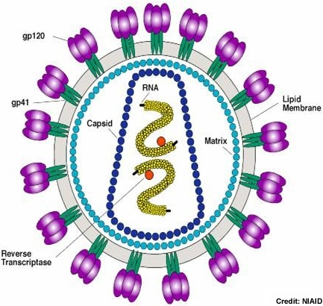
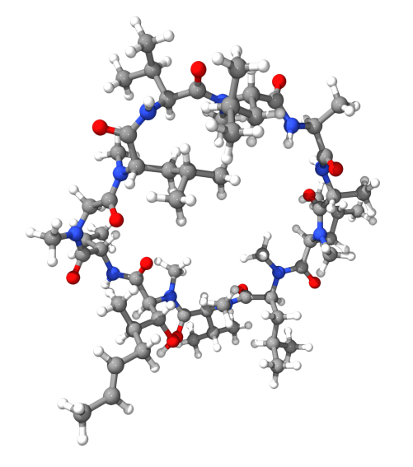
CypA: Cyclophilin A
165 residues, 18 kDa
Binds to the HIV-1 capsid protein.
Important in the action of immunosuppressant drug CsA: cyclosphorin
Heal, et al., Biophys J. 108, 1739-1746 (2015)

Slide 31
HIV-1 Lifecycle
1. Fusion
CypA
Rigidity analysis: FIRST
2. Reverse Transcriptase
3. Integrase
Coarse-grained simulations: FRODA
4. Transcription
5. Protease
Experiments: H-D exchange NMR (HDX)
6. Budding
http://www.thebody.com/content/art53763.html
Notes:
FIRST: no neat picture.
CG sims = more sophisticated. Influence on dynamic profile.
Experiments. HDX. Why? Interesting paper, experimental data out there.

Slide 32


The concept of a folding core
Residues which fold early perhaps particularly important, this set is call the folding core
Experimental determination:
  (A) Targeted mutations to determine impact on folding
  (B) Hydrogen-deuterium exchange (HDX) NMR experiments,
    slowly exchanging residues are “inside”, results consistent with folding core picture
Theoretical determination:
  Largest part of the protein that remains rigid before final collapse into unconnected and much smaller rigid units.

Slide 33
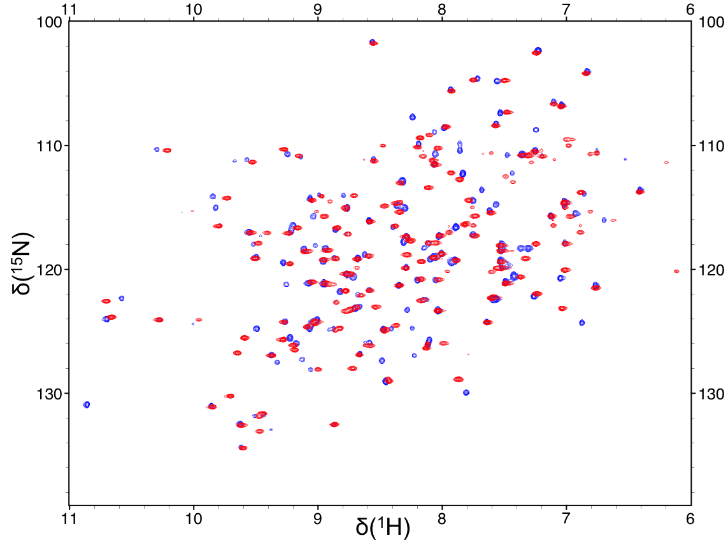
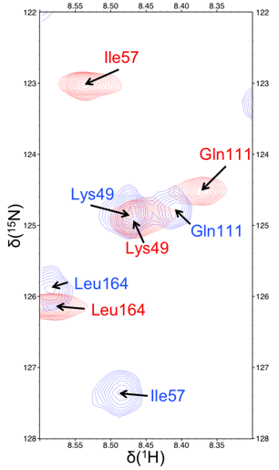
Heteronuclear Single Quantum Coherence (HSQC) spectra
Shift of NMR resonances compared to free H, N resonances
Shift is due to chemical environment, i.e. bonds and hence distance to neighbor atoms and their types.
Red: CypA
Blue: CypA-CsA

Slide 34
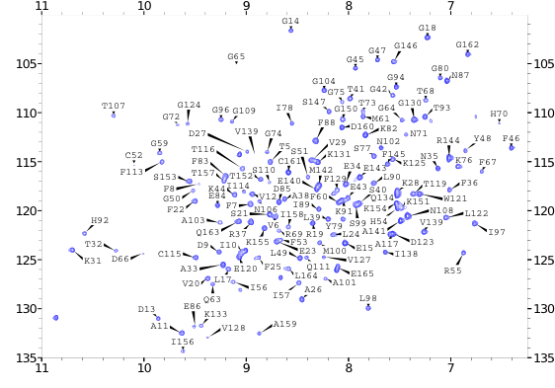
Assigning amino acids to chemical shifts
Difficult problem
Takes months (here 7)
Computing approach does not work
We tried neural nets, only 40% accuracy
δ(¹⁵N)
δ(¹H)

Slide 35
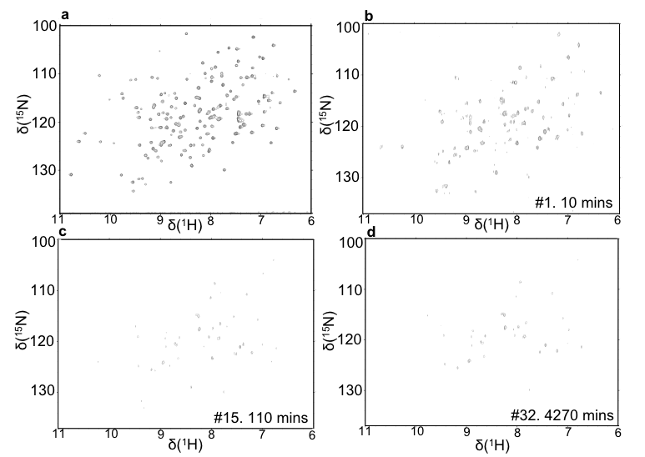
HXD results for CypA-CsA
Residues at outside exchange faster
H->D, no signal for D
Hence remaining signal from folding core
Long experiment, 4270 mins= 71hrs = 3 days

Slide 36

Experiments and theory
Experiment
Theory
With a drug
No drug

Slide 37
Coarse-grained simulations
FRODA used to track the burial distance of each amide proton during simulations.
Combined mobility data with rigidity analysis.
HDX
With a drug
FIRST + FRODA
No drug
70

Slide 38


Many cores, one winner (?)
Specificity α, ratio of correct theory prediction
Sensitivity γ, percentage (/100) of agreement with exp.
Enhancement ε, how much better than random

Slide 39







Conclusions
rapid prototyping tool for flexibility and motion prediction
can handle many hundreds of residues
agrees reasonably well with MD and is great if used in partnership
but does not give “physical” trajectories and/or temperatures
Jimenez-Roldan et al., submitted to Biophysical Journal, (2013)
Heal et al., Bioinformatics 28 (3), 350-357 (2012)
Heal, et al., Biophys J. 108, 1739-1746 (2015)

Slide 40
Reading material
Wells, S. A., Jimenez-Roldan, J. E. & Römer, R. A. “Comparative analysis of rigidity across protein families”. Phys Biol 6, 046005–046011 (2009).
Jimenez-Roldan, J. E., Freedman, R. B., Römer, R. A. & Wells, S. A. “Rapid simulation of protein motion: merging flexibility, rigidity and normal mode analyses”. Phys Biol 9, 016008 (2012).
Li, H. et al. Protein flexibility is key to cisplatin crosslinking in calmodulin. Protein Science 21, 1269–1279 (2012).
J.E. Jimenez-Roldan, M. Bhattacharyya, S.A. Wells, R.A. Römer, S. Vishweshwara and R.B. Freedman, "The dynamics and flexibility of protein disulphide-isomerase (PDI): predictions of experimentally-observed domain motions”. submitted to Biophysical Journal, (2013)
"Characterization of Folding Cores in the Cyclophilin A-Cyclosporin A Complex“, J. Heal, S. A. Wells, C. A. Blindauer, R. B. Freedman, R. A. Römer, Biophys J. 108, 1739-1746 (2015)
"Does Deamidation Cause Protein Unfolding? A Top-Down Tandem Mass Spectrometry Study“, A. J. Soulby, J. Heal, M. P. Barrow, R. A. Römer, P. B. O'Connor, accepted for publication in Protein Science, (2015)

