Slide 1

A variety of partially solvable models:
From closed spin chains to open spin chains
[Phys. Rev. B 109, 104307 (2024), arXiv:2409.03208, Work in progress with KPP]
Mathematical Physics for Quantum Science
@Hangzhou, Nov. 1-10
Chihiro Matsui (The University of Tokyo)

Slide 2




Collaborators
Hosho Katsura
(The University of Tokyo)
Chiara Paletta
(Ljubljana University)
Balazs Pozsgay
(Eötvös Loránd University)
Naoto Tsuji
(The University of Tokyo)

Slide 3

Outline
What is “partial solvability”?
  Definition of partial solvability
  Thermalization & quantum many-body scars (QMBS)
Closed partially solvable models
  Restricted spectrum generating algebra (rSGA)
  Hilbert space fragmentation (HSF)
Open partially solvable models
  Restricted spectrum generating algebra (rSGA)
  Hilbert space fragmentation (HSF)
Concluding remarks

Slide 4
Outline
What is “partial solvability”?
  Definition of partial solvability
  Thermalization & quantum many-body scars (QMBS)
Closed partially solvable models
  Restricted spectrum generating algebra (rSGA)
  Hilbert space fragmentation (HSF)
Open partially solvable models
  Restricted spectrum generating algebra (rSGA)
  Hilbert space fragmentation (HSF)
Concluding remarks

Slide 5
Integrability
(Quantum) Integrable systems
  No clear definition.
  Often said to be “integrable” if the Yang-Baxter structure exists.
Decomposing a many-body scattering into
a sequence of two-body scatterings does not
depend on the way of decomposition.

Slide 6
Integrability
(Quantum) Integrable systems
  No clear definition.
  Often said to be “integrable” if the Yang-Baxter structure exists.
  Never thermalize.
  ⇒ Violation of (strong) eigenstate thermalization hypothesis (ETH)
≒ Typicality
[Deutsch (1991), Srednicki (1994),…]
[Biroli et al. (2010), Iyoda et al. (2017)]

Slide 7
Partial Solvability
Partially solvable systems
  Hamiltonians with some solvable energy eigenstates (not all).
  Hamiltonians with the block diagonal structure.
Solvable (invariant) subspace
⇒ Solvability does not necessarily come from integrability.
e.g. Projector embeddings
Restricted spectrum generating algebra (rSGA)
Hilbert space fragmentation (HSF)
[Shiraishi et al. (2017)]
[Moudgalya et al. (2018)]
[Vefek et al. (2017), Moudgalya et al. (2020)]
[Pai et al. (2019), Sala et al. (2020), Khemani et al. (2020)]
Notes:
Spectrum generating algebra
More details for solvability mechanism?

Slide 8
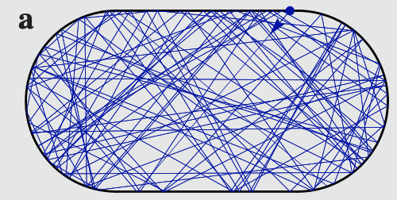
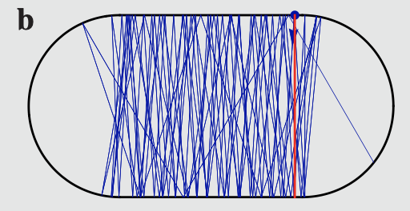
Partial Solvability
Partially solvable systems
  Hamiltonians with some solvable energy eigenstates (not all).
  Hamiltonians with the block diagonal structure.
  Partially non-thermalize. “Quantum many-body scars (QMBS)”
Solvable (invariant) subspace
[Shiraishi et al. (2017),
Turner et al. (2017),
⇒ Weakly violate ergodicity in Hilbert space.
≒ Principle of equal probability
Bernien et al. (2017)]
e.g. Scar in stadium billiard
a. starting away from
unstable periodic trajectory
[Serbyn et al. (2021)]
b. starting from near
unstable periodic trajectory
Notes:
Spectrum generating algebra
More details for solvability mechanism?

Slide 9
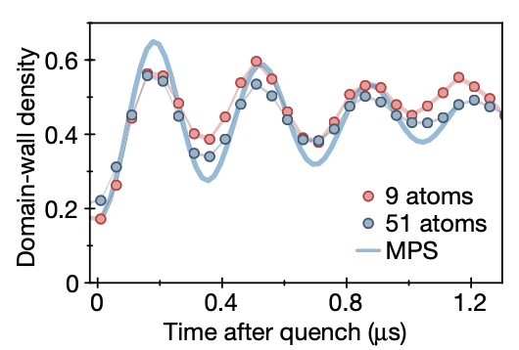
Thermalization & QMBS
QMBS exhibit
  Persistent oscillation in local observables.
  Relatively small entanglement entropy
  compared to those of thermal states .
Matrix product states
  Have entanglement entropy estimated by their
  bond dimensions from above.
  With a finite bond dimension is a good benchmark
  for finding QMBS.
Domain-wall density after the quench from
on the Rydberg atom chain.
(●: Excited state; ○: Ground state)
[Bernien et al. (2017); Nature 551, 579 (Fig. 6b)]
Notes:
図

Slide 10
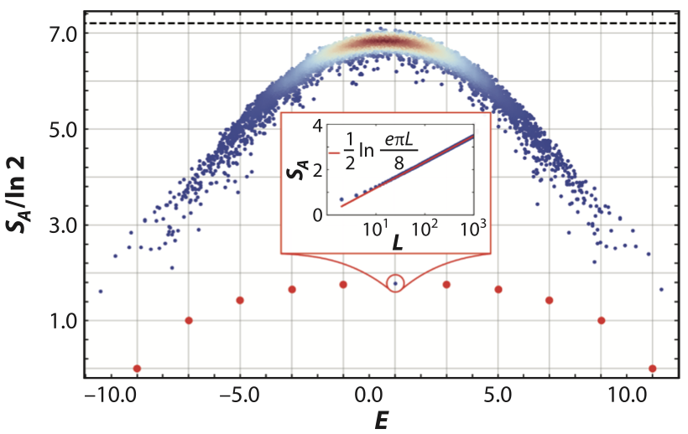
Thermalization & QMBS
QMBS exhibit
  Persistent oscillation in local observables.
  Relatively small entanglement entropy
  compared to those of thermal states .
Matrix product states
  Have entanglement entropy estimated by their
  bond dimensions from above.
  With a finite bond dimension is a good benchmark
  for finding QMBS.
Half-chain entanglement entropy of
the spin-1 XY model
in zero-magnetization sector.
[Chandran et al. (2003); Ann. Rev. 14, 443 (Fig. 1c)]
Notes:
図

Slide 11
Outline
What is “partial solvability”?
  Definition of partial solvability
  Thermalization & quantum many-body scars (QMBS)
Closed partially solvable models
  Restricted spectrum generating algebra (rSGA)
  Hilbert space fragmentation (HSF)
Open partially solvable models
  Restricted spectrum generating algebra (rSGA)
  Hilbert space fragmentation (HSF)
Concluding remarks

Slide 12
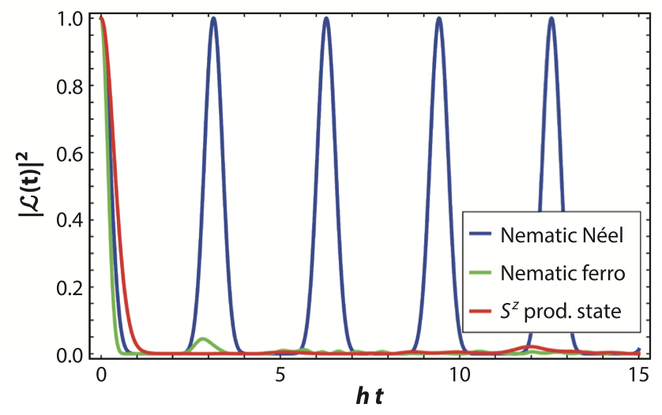
Restricted Spectrum Generating Algebra
Restricted spectrum-generating algebra (rSGA)
  Partial dynamical symmetry
  The solvable subspace is systematically constructed if is an energy eigenstate:
[Arno et al. (1988), Yang (1989)]
[Moudgalya et al. (2018)]
: Local operator
Strong revivals observed in dynamics of Loschmidt echo
for the spin-1 XY from each initial state.
[Chandran et al. (2023); Ann. Rev. 14, 443 (Fig. 1d)]

Slide 13
Restricted Spectrum Generating Algebra
Restricted spectrum-generating algebra (rSGA)
  Partial dynamical symmetry
  The solvable subspace is systematically constructed if is an energy eigenstate:
  is the invariant subspace of .
[Arno et al. (1988), Yang (1989)]
[Moudgalya et al. (2018)]
: Local operator

Slide 14
Restricted Spectrum Generating Algebra
Simple example: free fermion model
  “Spectrum generating algebra” (SGA)
  Energy eigenstates
⇒ Provides the spectrum for a tower of states
Notes:
Hamiltonia

Slide 15
Restricted Spectrum Generating Algebra
Example of rSGA: perturbed spin-1 XY model
  Spin-1 operators
  Non-integrable spin-1 chain. (Not all energy eigenstates are solvable. )
[Schecter et al. (2019)]
Notes:
Hamiltonia

Slide 16
Restricted Spectrum Generating Algebra
Example of rSGA: perturbed spin-1 XY model
  Trivial energy eigenstate
  Subspace of quasiparticle (bimagnon) excitations
  is the solvable subspace due to the spectrum
  generating algebra
[Schecter et al. (2019)]
[Chandran et al. (2023);
Ann. Rev. 14, 443 (Fig. 1d)]
Energy
Notes:
Hamiltonia

Slide 17
Restricted Spectrum Generating Algebra
Example of rSGA: AKLT-type model
  Non-integrable spin-1 chain. (Not all energy eigenstates are solvable. )
  The ground state and some excitation states were known to be solvable for AKLT.
[Moudgalya et al. (2018), CM (2024)]
: ALKT at .
[Affleck et al. (1987), Arovas (1989)]
Notes:
Hamiltonia

Slide 18
Restricted Spectrum Generating Algebra
Example of rSGA: AKLT-type model
  The exact zero-energy state is written by the matrix product state:
  is determined by the boundary condition.
  ( for the periodic boundary; for an open boundary)
[Moudgalya et al. (2018), CM (2024)]
: Pauli matrices

Slide 19
Restricted Spectrum Generating Algebra
Example of rSGA: AKLT-type model
  The exact zero-energy state is written by the matrix product state:
  Quasiparticle-picture for the excitation states:
[Moudgalya et al. (2018), CM (2024)]
: Local divergence condition/
Frustration-free condition for
: Creates a quasiparticle with momentum .
: No double/adjacent occupations are allowed.
Notes:
Eとh0000の関係

Slide 20
Restricted Spectrum Generating Algebra
Example of rSGA: AKLT-type model
  Restricted spectrum-generating algebra:
  Embedded equally-spaced energy spectrum
[Moudgalya et al. (2018), CM (2024)]
Energy
: Embedded equally-spaced spectrum
⇒ Identical & non-interacting quasiparticles

Slide 21
Beyond rSGA
Generalization of the AKLT-type model
  Quasiparticle-excitation states
  Repulsive property is lost.
[CM (2024)]
: Carrying momentum
: Carrying momentum
Notes:
figure for oscillation

Slide 22
Beyond rSGA
Perturbed XXC model
  is solvable subspace of .
[CM (2024)]
XXC model (integrable)
: Bethe-like state

Slide 23
Beyond rSGA
Perturbed XXC model
  is solvable subspace of .
[CM (2024)]
XXC model (integrable)
: Bethe-like state
: Bethe-ansatz equations
for s=1/2 XXX

Slide 24
Beyond rSGA
Perturbed XXC model
  is solvable subspace of .
[CM (2024)]
XXC model (integrable)
Embedded s=1/2 XXX spectrum (not equally-spaced)
⇒ Interacting quasiparticles

Slide 25
Beyond rSGA
Perturbed XXC model
  is solvable subspace of .
[CM (2024)]
XXC model (integrable)
Embedded s=1/2 XXX spectrum (not equally-spaced)
⇒ Interacting quasiparticles
Why? ⇒ Hilbert-space fragmentation

Slide 26
Hilbert space fragmentation
Hilbert-space fragmentation (HSF; Krylov restricted thermalization)
  Exponentially-many block diagonal structure.
  Fragmented subspaces are not distinguished by
  obvious local symmetries of .
  Solvable subspaces are sometimes embedded
  (not always).
[Retort et al. (2003), Pai et al. (2019)]

Slide 27
Hilbert space fragmentation
Simple example: Sato’s model
  Non-integrable arbitrary spin-s chain.
  The interactions only exchange the neighboring configurations.
[Sato (1995)]

Slide 28
Hilbert space fragmentation
Simple example: Sato’s model
  Non-integrable arbitrary spin-s chain.
  The entries in each configuration never change by the interactions
  ⇒ Hilbert-space fragmentation (according to multisets of configuration entries).
[Sato (1995)]
: All in the same invariant subspace.

Slide 29
Hilbert space fragmentation
Simple example: Sato’s model
  Non-integrable arbitrary spin-s chain.
  The model is integrable in the subspaces given by
[Sato (1995)]
: Vacuum
: Particles
with
Anisotropy depending on .

Slide 30
Hilbert space fragmentation
Example: spin-s model with HSF
  such that .
  No exchange of species occurs in each subgroup A, B.
exchanging terms

Slide 31
Embedded Integrable Models in HSF
Example: XXC model
  Integrable spin-1 chain.
[Maassarani (1997, 1999), de Leeuw et al. (2023)]
anisotropy parameter
becomes XXZ model
by identifying & .

Slide 32
Embedded Integrable Models in HSF
Example: XXC model
  The configuration of 0 & 2 never changes by the interactions.
  Hilbert-space fragmentation occurs according to the IS.
[Maassarani (1997, 1999), de Leeuw et al. (2023)]
exchange terms
“Irreducible string (IS)”
[Dhar et al. (1993), Barma et al (1994), Menon et al. (1997), Dhar (1997)]
e.g.
e.g.
(IS = )

Slide 33
Embedded Integrable Models in HSF
Example: perturbed XXC model
  Projector onto the fully-polarized IS (resp. )
[CM (2024), in preparation with KPP]
: vanishing terms
s=1/2 XXZ model!
(resp. )

Slide 34
Embedded Integrable Models in HSF
Example: deformed XXC model
  Projector onto the fully-polarized IS (resp. )
[CM (2024), in preparation with KPP]
: vanishing terms
: anisotropy shifting terms
s=1/2
XXZ model!
(resp. )

Slide 35
Embedded Integrable Models in HSF
Example: perturbed XXC model
  Projector onto the alternating IS
[CM-Tsuji (2024), in preparation with KPP]
: vanishing terms
s=1/2 XXZ model!
Partial solvability in open quantum systems?

Slide 36
Embedded Integrable Models in HSF
Example: deformed XXC model
  Projector onto the alternating IS
[CM (2024), in preparation with KPP]
: vanishing terms
: anisotropy shifting terms
s=1/2
XXZ model!
Partial solvability in open quantum systems?

Slide 37
Embedded Integrable Models
Example of HSF: Deformed XXC model
  Partially solvable spin-1 chain.
  Integrable at the (isotropic) XXC point .
[CM (2023)]
XXC model (integrable)
[Maassarani (1997, 1999), de Leeuw et al. (2023)]

Slide 38
Embedded Integrable Models
Example of HSF: Deformed XXC model
  The configuration of 0 & 2 never changes by the interactions.
[CM (2023)]
XXC model (integrable)
“Irreducible string (IS)”
[Dhar et al. (1993), Barma et al (1994), Menon et al. (1997), Dhar (1997)]
e.g.)
Original configuration

Slide 39
Embedded Integrable Models
Example of HSF: Deformed XXC model
  The configuration of 0 & 2 never changes by the interactions.
[CM (2023)]
XXC model (integrable)
“Irreducible string (IS)”
[Dhar et al. (1993), Barma et al (1994), Menon et al. (1997), Dhar (1997)]
e.g.)
Original configuration
Irreducible string
×
×
×
×
×
×
×
×

Slide 40
Embedded Integrable Models
Example of HSF: Deformed XXC model
  The configuration of 0 & 2 never changes by the interactions.
  Hilbert-space fragmentation occurs according to the IS.
[CM (2023)]
XXC model (integrable)
“Irreducible string (IS)”
[Dhar et al. (1993), Barma et al (1994), Menon et al. (1997), Dhar (1997)]
e.g.
(IS = )

Slide 41
Embedded Integrable Models
Example of HSF: Deformed XXC model
  Solvable in the subspace spanned by the alternating irreducible-string states.
[CM (2023)]
XXC model (integrable)
[Work in progress with Pozsgay et al.]

Slide 42
Embedded Integrable Models
Example of HSF: Deformed XXC model
  Stay partially-solvable by adding more perturbations:
[CM (2023)]
[Work in progress with Pozsgay et al.]
The -term changes the anisotropy but does not violate the irreducible strings.
The -term violates the irreducible strings including or . ⇒ Violates entire HSF.

Slide 43
Outline
What is “partial solvability”?
  Definition of partial solvability
  Thermalization & quantum many-body scars (QMBS)
Closed partially solvable models
  Restricted spectrum generating algebra (rSGA)
  Hilbert space fragmentation (HSF)
Open partially solvable models
  Restricted spectrum generating algebra (rSGA)
  Hilbert space fragmentation (HSF)
Concluding remarks

Slide 44
Beyond Isolated Quantum Systems
Lindblad master equation
  Is the most general CPTP map under the assumptions:
  Markovian time evolution & Direct product initial state.
Steady state
as the fixed point of
: Dissipation terms
Quantum jump operator

Slide 45
Beyond Isolated Quantum Systems
Lindblad master equation
  Sometimes has the exactly solvable steady state.
Steady state
as the fixed point of
: Dissipation terms
Quantum jump operator
Fully solvable ⇒ Free-fermionization, Bethe-ansatz solvability, Triangularization, etc.
[Prosen (2008), Medvedyeva et al. (2016), Buca et al. (2020)]
Partially solvable ⇒ Bulk solvability + “a good choice of dissipators”
[Prosen (2013), Karevski et al. (2013)]

Slide 46
Beyond Isolated Quantum Systems
Lindblad master equation
  Sometimes has the exactly solvable steady state.
Steady state
as the fixed point of
: Dissipation terms
Quantum jump operator
Fully solvable ⇒ Free-fermionization, Bethe-ansatz solvability, Triangularization, etc.
[Prosen (2008), Medvedyeva et al. (2016), Buca et al. (2020)]
Partially solvable ⇒ Bulk solvability + “a good choice of dissipators”
[Prosen (2013), Karevski et al. (2013)]
Non-Hermitization of rSGA Hamiltonian
[Tindall et al. (2020)]
Partial bulk solvability
[Work in progress with Tsuji]
Notes:
Reference for “dark states”

Slide 47
Beyond Isolated Quantum Systems
Lindblad master equation
  Sometimes has the exactly solvable steady state.
  Can partial solvability be robust against the boundary dissipators?
Steady state
as the fixed point of
: Dissipation terms
Quantum jump operator
Fully solvable ⇒ Free-fermionization, Bethe-ansatz solvability, Triangularization, etc.
[Prosen (2008), Medvedyeva et al. (2016), Buca et al. (2020)]
Partially solvable ⇒ Bulk solvability + “a good choice of dissipators”
[Prosen (2013), Karevski et al. (2013)]
Non-Hermitization of rSGA Hamiltonian
[Tindall et al. (2020)]
Partial bulk solvability
[Work in progress with Tsuji]
Notes:
Reference for “dark states”

Slide 48
Beyond Isolated Quantum Systems
Lindblad master equation
  Sometimes has the exactly solvable steady state.
  Can partial solvability be robust against the boundary dissipators?
Steady state
as the fixed point of
: Dissipation terms
Quantum jump operator
bulk dissipators
boundary dissipators
completely solvable
[Prosen (2008) et al.]
[Paletta et al. (2024)]
steady state solvable
[Prosen (2013)]
partially solvable
[Tindall et al. (2020)]
our model
[CM-Tsuji (2024)]
Notes:
Reference for “dark states”

Slide 49
HSF-induced solvable eigenmodes
System coupled to boundary dissipators
Thermofield double vector expression
  Evolution of the density matrix
Can be an integrable Hamiltonian
in a certain subspace?
: Non-Hermitian
effective Hamiltonian

Slide 50
HSF-induced partially solvable Liouvillian
Example: XXC Hamiltonian coupled to boundary dissipators
  Spin-1 XXC Hamiltonian
  Boundary dissipators
  Effective non-Hermitian Hamiltonian
[CM-Tsuji (2024)]
⇒ HSF by config. of 0 & 2
⇒ violate integrability
thermofield double
⇒ Two XXC chains coupled at the boundaries.
Notes:
XXCの図！

Slide 51
HSF-induced partially solvable Liouvillian
Example: XXC Hamiltonian coupled to boundary dissipators
  Effective non-Hermitian Hamiltonian
[CM-Tsuji (2024)]
Two terms irrelevant in the subspace of alternating irreducible strings.
(projector onto
the alternating subspace)
⇒ Two decoupled XXC chains
The other terms work as the (imaginary) boundary magnetic fields.

Slide 52
HSF-induced partially solvable Liouvillian
Example: XXC Hamiltonian coupled to boundary dissipators
  Projected effective non-Hermitian Hamiltonian
  becomes integrable when
  Mapped to s=1/2 XXZ spin chain with
  diagonal boundaries
[CM-Tsuji (2024)]
identifying the states
&
Spectrum derived by Bethe ansatz for spin-1/2 XXZ!!

Slide 53
HSF-induced solvable eigenmodes
Example: XXC Hamiltonian coupled to boundary dissipators
  Eigenstates of effective Hamiltonian
[CM-Tsuji (2024)]
⇒ Derived by Bethe ansatz for spin-1/2 XXZ.
Notes:
Tables

Slide 54
HSF-induced partially solvable Liouvillian
Example: XXC Hamiltonian coupled to boundary dissipators
  Eigenstates of effective Hamiltonian
[CM-Tsuji (2024)]
Full Liouvillian has degenerate steady states
including the fully polarized state.
The steady state in the integrable subspace
is given by the product state .
full eigenvalues of
No persistent oscillation unlike the rSGA-induced
solvable steady states.
eigenvalues of
in the solvable subspace
Notes:
Tables

Slide 55
rSGA-induced solvable eigenmodes
System coupled to boundary dissipators
  System with rSGA
  Quasiparticle baths at the edges
⇒ Quasiparticle excitations carrying momentum
⇒ Doping quasiparticles at the boundaries
Fully occupied steady state?

Slide 56
rSGA-induced solvable eigenmodes
System coupled to boundary dissipators
  A pure state becomes the steady state if
  Some solvable bulk energy eigenstates satisfy the dark state conditions.
⇒ Energy eigenstate
cf. Dark state
[Baumgartner et al. (2008)]
⇒ Dark state

Slide 57
rSGA-induced solvable eigenmodes
Example: AKLT-like model + spin-2 magnon baths
  AKLT-like model
  Spin-2 magnon baths at the edges
Boundary vectors
⇒ Four degenerate zero-energy states.
⇒ Doping spin-2 magnons at the boundaries

Slide 58
rSGA-induced solvable eigenmodes
Example: s=1 spin chains with rSGA + spin-2 magnon baths
  The subspace consists of the dark states.
  Any diagonal density matrix in becomes the steady states.
[CM-Tsuji (2024)]
⇒ Eigenstates of the Hamiltonian
⇒ Dissipators are irrelevant.
(Robust eigenstates against boundary dissipators)

Slide 59
rSGA-induced solvable eigenmodes
The ratio of the number of trajectories for each
(Left) The initial state does not overlap with solvable states ⇒ Dominated by states with large .
(Right) The initial state does overlap with solvable states ⇒ States with small survive!

Slide 60
rSGA-induced solvable eigenmodes
Example: s=1 spin chains with rSGA + spin-2 magnon baths
  Short proof
[CM-Tsuji (2024)]
Set the boundary vectors s.t.

Slide 61
rSGA-induced solvable eigenmodes
Example: s=1 spin chains with rSGA + spin-2 magnon baths
  Other solvable eigenmodes in
  Persistent oscillation emerges.
[CM-Tsuji (2024)]
⇒ Eigenstates of
the Hamiltonian
⇒ Dissipators are irrelevant.
(Robust eigenstates against boundary dissipators)

Slide 62
rSGA-induced solvable eigenmodes
Time evolution of the local magnetization starting from a nearly Neel state at
(Left) The initial state does not overlap with solvable states ⇒ No oscillations
(Right) The initial state does overlap with solvable states ⇒ Long-lived oscillations emerge!

Slide 63
Outline
What is “partial solvability”?
  Definition of partial solvability
  Thermalization & quantum many-body scars (QMBS)
Closed partially solvable models
  Restricted spectrum generating algebra (rSGA)
  Hilbert space fragmentation (HSF)
Open partially solvable models
  Restricted spectrum generating algebra (rSGA)
  Hilbert space fragmentation (HSF)
Concluding remarks

Slide 64
Concluding remarks
Closed partially solvable models
  Are described by Hamiltonians with the block diagonal structure, which is induced by the extra algebraic structure in the solvable subspace.
  e.g. rSGA, Yang-Baxter equation, etc.
  Embedded integrability due to HSF is not violated by a certain kinds of site-dependent perturbations.
Boundary dissipative spin chains
  can have solvable eigenmodes inherited from the partially solvable system Hamiltonians.
  reach a non-trivial steady state or never reach a steady state by exhibiting long-lived oscillations.

Slide 65
Future works
From the phenomenological viewpoints,
  Can we observe the KPZ universality class in the integrable subspace?
  ⇒ Robustness of the KPZ universality class against boundary conditions.
  Overlap between the initial state & solvable eigenmodes?
  ⇒ Needs determinant formula for boundary cases.
From the mathphys aspects,
  What is the algebraic structure behind the XXC & related models?
  What are the conserved quantities for partially solvable models?
  Is it possible to extend the notion of partial integrability to QFT models?
[de Leeuw et al. (2023)]
Thank you for listening!

