Slide 1





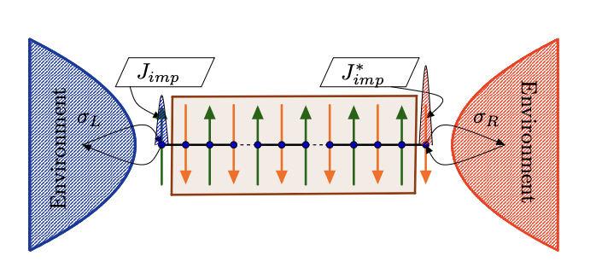

Quantum impurity in interacting environments – three systems, one phase diagram
Natan Andrei Rutgers university
Pradip Kattel
Rutgers University
Parmesh Pasnoori
University of Maryland
Patrick Azaria
Sorbonne Universite’
Colin Rylands
SISSA
Abay Zhakenov
Rutgers University
Environment
Quantum spin 1/2
1-D superconductor coupled to a Kondo spin
International Worksop on Mathematical physics in Quantum Science Nov 1-10 2024 Hangzhou, China

Slide 2
Outline
The Kondo effect in metals - reminder
The Kondo effect is a 1-d superconductor
- YSR bound states in a 3-d BCS superconductor
- Quantum fluctuations and destruction of YSR states
- The phase diagram: competition between fluctuations and the condensate
The Kondo effect in a dissipating environment
- Non Hermitian Kondo model
- The phase diagram : competition between dissipation and fluctuations
The Kondo effect on a PT invariant dissipating lattice
- The phase diagram : competition dissipation and fluctuations on the lattice

Slide 3
Kondo effect in a metal
Magnetic impurity in a sea of gapless non-interacting electrons:
Metal: Fermi sea
Metal: Free gas of electrons
impurity
Electrons spin density at impurity site
Local spin impurity coupled to the Fermi sea via spin exchange interaction

Slide 4


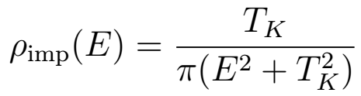
Kondo effect in a metal
For spin ½ impurity is screened
- Singlet Ground State
- Many-body screening (Kondo cloud)
Magnetic susceptibility and resistivity
increase as T 0
Non-perturbative scale
Impurity D.O.S
Magnetic impurity in a sea of gapless fermions:

Slide 5
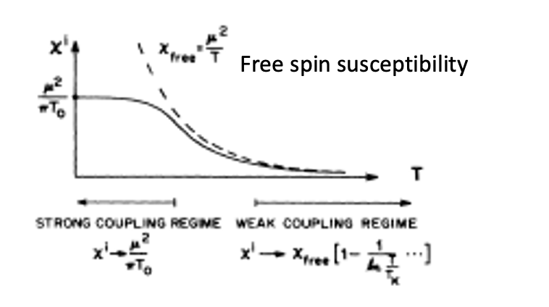
Kondo effect in a metal (non interacting gas of electrons)
RG interpretation
quantum spin 1/2
gas of electrons coupled to a Kondo spin
wc
SC
At low energy scales the effective coupling constant increases and flows to strong coupling
The strong coupling fixed point describes a screened impurity, a local potential scattering center with scattering phase shift
Impurity entropy flows under RG

Slide 6

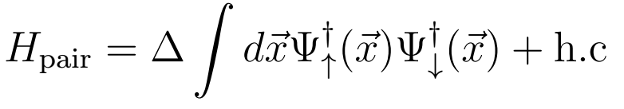
Kondo effect in a BCS superconductor – attractive interaction among electrons
Replace the metal with a superconductor
Competition between screening and Cooper pair formation
YSR approach: Mean Field theory + classical spin
Kondo impurity interacts with Cooper pairs
Yu (1965), Shiba (1968), Rusinov (1969)

Slide 7

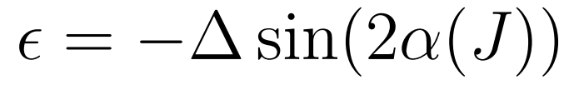

YSR approach: Classical spin in a BCS superconductor
- BCS superconductor are weakly fluctuating
BCS superconductor, classical spin
Screening is done by a localized bound state
BS energy is function of phase
Mediates a 1st order QPT
Impurity quantum fluctuations - dress phase shift
Yu-Shiba-Rusinov state
with
Screened GS
Unscreened GS
1st Order QCP
Yu (1965), Shiba (1968), Rusinov (1969)
Sakai et.al. J.Pys.Soc.Jpn. (1993)

Slide 8
Some applications: YSR states & topology
Helical chain of impurities on a SC
YSR states hybridize, form a band below SC gap
Realizes a topological SC, Majorana edge modes
Nadj-Perge, et.al. PRB (2013), Pientka, et.al. PRB (2013), Nadj-Perge, et.al. Science (2014),

Slide 9

Q: What about Kondo effect SC’s with strong fluctuations?
Fluctuating superconductors
In BCS superconductors fluctuations are usually neglected
Ex: 1-d charge conserving superconductor coupled to a Kondo impurity

Slide 10
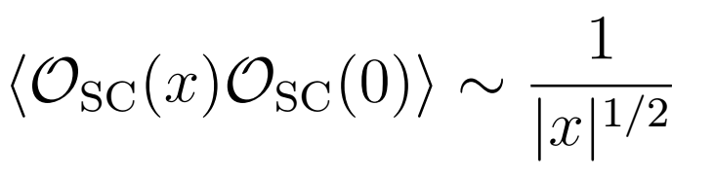


The Impurity: Kondo spin attached at the edge
quantum spin 1/2
The superconducting Bulk
Strong e-e correlations
Attractive spin exchange interaction
Spin-charge separation
Gapped spinons
Gapless holons
QLR SC order parameter :
Spin singlet superconductor
1-D superconductor coupled to a Kondo spin
Charge conserving 4 fermion spin-spin attractive interaction
Open boundary conditions:

Slide 11






Model is integrable for any g (bulk coupling) and J (Kondo coupling)
Kondo
YSR
RG invariant
LM, unscreened
always flows to strong coupling
flow depends on initial value
Impurity is screened 1. in Kondo phase 2. by a local bound state d<1
The bulk is gapped
Three regimes - depending on relative values of g and J
  Kondo phase
  YSR phase
  Local moment phase
Convenient parameters
Bulk parameter
RG invariant

Slide 12
From Classical to Quantum description
Classical impurity & semi-classical bulk
Classical impurity & quantum bulk
Quantum impurity & quantum bulk
Classical
Quantum

Slide 13

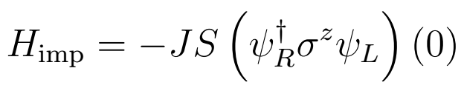


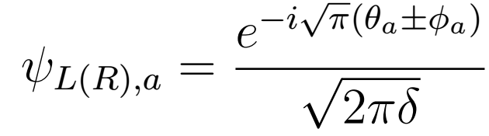

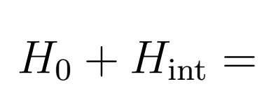
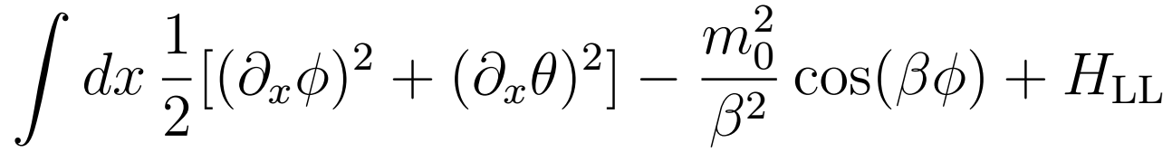
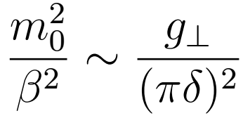
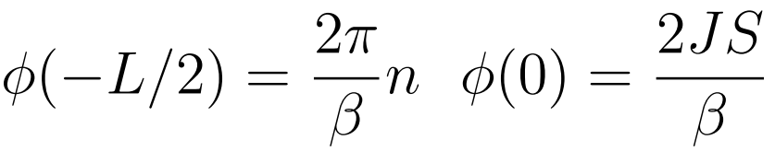
Classical impurity, semiclassical bulk
Classical
Quantum
The impurity: Take the limit with constant
The SC (bosonized)
Chiral rotation removes impurity but changes b.c.
Spin part
charge part

Slide 14




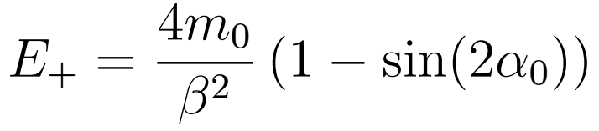
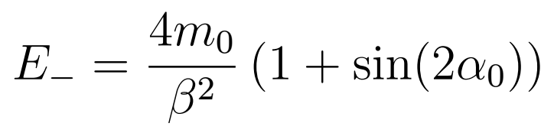

Classical impurity, semiclassical bulk
Semiclassical bulk: Take the limit
  SG model: Spectrum has kinks and anti-kinks
Ground state/YSR state
kink with , anti-kink with
Same results as for BCS SC: YSR state everywhere
Screened GS
Unscreened GS
1st Order QCP

Slide 15
Classical
Classical impurity & semiclassical bulk
Classical impurity & quantum bulk
Quantum impurity & quantum bulk
Quantum

Slide 16

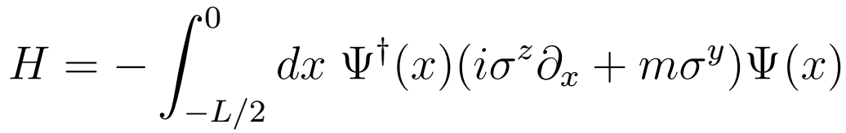
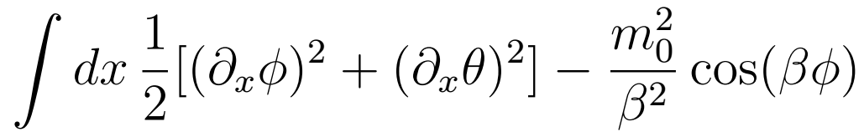
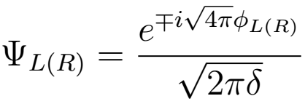


Quantum bulk, classical impurity
Classical
Take the “opposite” limit , restore bulk fluctuations
Dirac equation with twisted b.c.
refermionize
Luther & Emery, PRL (1974)

Slide 17
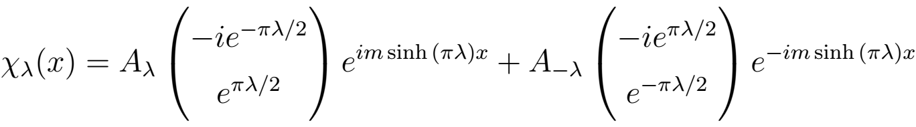
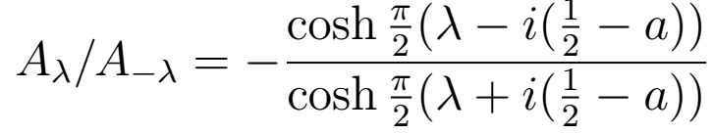
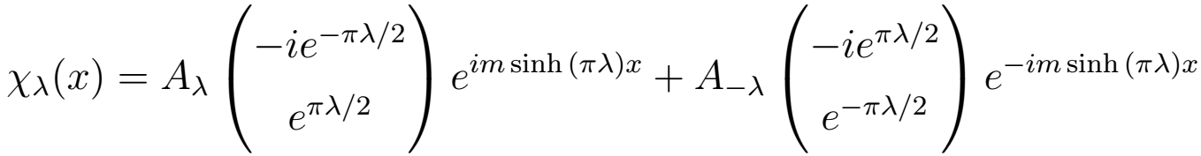


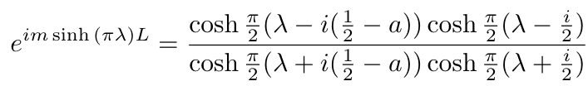


Quantum bulk, classical impurity
Dirac wave function with twisted b.c.
  Energy , rapidity parameter
Boundary conditions lead to equations
  Ground state: fill all negative energy modes
  Excitations: gapped
Boundary phase shift
Pole/zero:

Slide 18


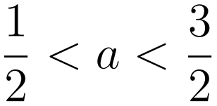

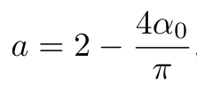
Quantum bulk, classical impurity
Pole indicates bound state - YSR
Only normalizable for
Energy is below gap
  Include in GS when negative
Screened GS
Unscreened GS
1st Order QCP
YSR region shrinks

Slide 19
Classical impurity & semiclassical bulk
Classical impurity & quantum bulk
Quantum impurity & quantum bulk
Classical
Quantum

Slide 20



The Quantum model
Classical
Quantum
The Hamiltonian of the system:
The Hamiltonian is integrable via Bethe Ansatz for arbitrary &
Pasnoori, Rylands & Andrei, PRR (2020)

Slide 21
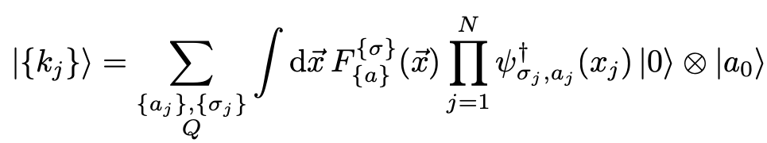


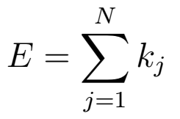
Quantum model: Bethe Ansatz approach
The Bethe states – divide configuration space to to (N+1) regions
  with the wave function in region Q:
Imposing open b.c. - the amplitude satisfies:
where:
is the monodromy matrix (transfering an electron from one edge to another)
Chiral index
Spin index
Amplitude in region Q – is related via S-matrix to another region Q’ where particles i,j are exchanged
- Spectral parameter, - spin momentum
The Energy with the allowed momenta

Slide 22
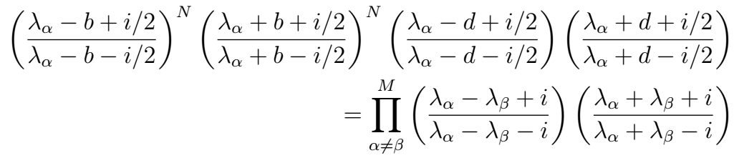
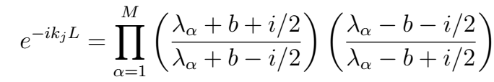
Quantum model:
- The BA equations :
g and J flow under RG
d is the RG invariant
i. Determine the spin momenta
bulk parameter
ii. Determine the allowed electron momenta
- The energy:
- Spin charge separation
- Gapless holons
- Gapful spinons

Slide 23


Quantum model: Bethe equations – the bulk terms
RG invariants and scales
The bulk parameter
Bulk scale, the gap
cutoff
Bulk solutions are strings (complex pairs) – gapped Spinons

Slide 24
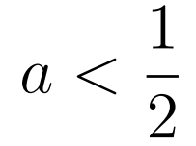
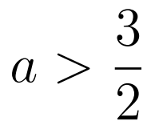

Quantum model: Bethe equations –the impurity terms
The impurity term
RG invariant
Note: the RG invariant can be real (denoted a) ore imaginary (denoted d)
or
Boundary spectrum: Three regimes depending on
Each phase is characterized by its own scale
meaning depending on the regime:
Kondo scale -
YSR bound state energy
Moment regime
Kondo regime
YSR regime
Moment regime

Slide 25

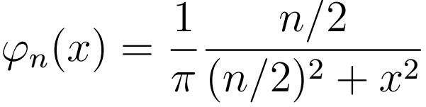
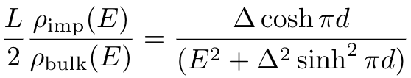

Quantum model: Solution in thermodynamic limit
Ground state has all distributed according to BAE: density of solutions
Solve for by Fourier Transform
bulk
impurity
boundary
The density of the spin-momenta:

Slide 26
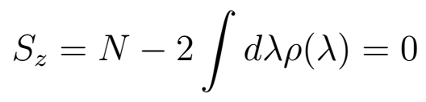
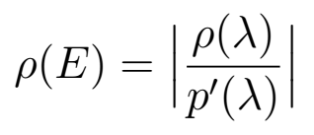
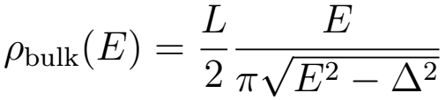
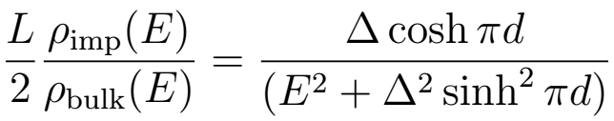

Quantum model: Kondo Regime
The total spin many body singlet
Density of states
Defines a renormalized Kondo scale
Smooth crossover from many-body to single particle screening
when

Slide 27


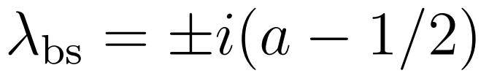




Quantum model: YSR regime
There exists three states with spin ,
corresponding to impurity being screened and
unscreened respectively.
The impurity is screened by a bound state
which is described by the close boundary string
Energy of the bound state is below the gap:
First order QPT at
Ground state has
- impurity screened
Ground state has no -impurity not screened

Slide 28

Quantum model: local moment regime
For have “wide” boundary string
Only a solution in presence of excitations
  Not a bound state, flips spin of impurity
Ground state is doubly degenerate
No YSR states, still some residual scale

Slide 29

The superconductor-Kondo Phase Diagram
B
A
A
Midgap leaked into bulk
Spin accumulation continuous across a=1/2
Local spin accumulation
cannot be removed

Slide 30
In Sum: Kondo effect in a 1-d superconductor
Semi-classical vs. Quantum
Quantum fluctuations
screened
unscreened
Quantum description
Semi-classical description
Three regimes
  Kondo
  YSR
  Unscreened
Two phases
  Screened
  Unscreened
Quantum fluctuations destroy YSR over most of the phase diagram

Slide 31
Dissipation-driven phases in the Non-Hermitian Kondo model
New platforms: ultracold atoms, superconducting bits, Rydberg atoms..
require study of open systems, effects of surroundings
One way to incorporate these effects – add non-Hermitian terms to Hamiltonian, induce non-unitary evolution (Approximate Lindblad dynamics)
A model of the non-Hermitian Kondo effect can be obtained by studying the two-body loss/gain induced by the inelastic scattering between ground states and excited states in ultracold alkaline earth atoms.
With a complex coupling constant

Slide 32
Open Kondo system
Example: AMO system of a two orbital fermionic quantum - Gas atoms (e.g. ) in a metastable excited state play the role of a spin S = 1/2 impurities
- Atoms in their ground state are mobile and act as itinerant spin S = 1/2 fermions.
- Two-body losses due to inelastic scattering between the impurity and itinerant atoms are enhanced in the singlet channel. Riegger et al ’18 (I. Bloch group)
Kondo system coupled to an environment:
Kondo cloud
coupling
Environment
Open Kondo System

Slide 33



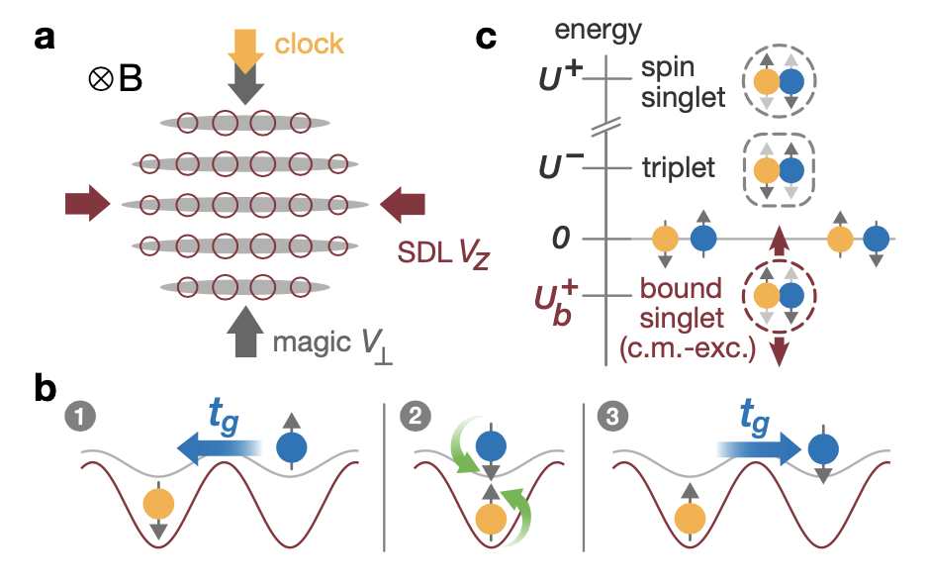
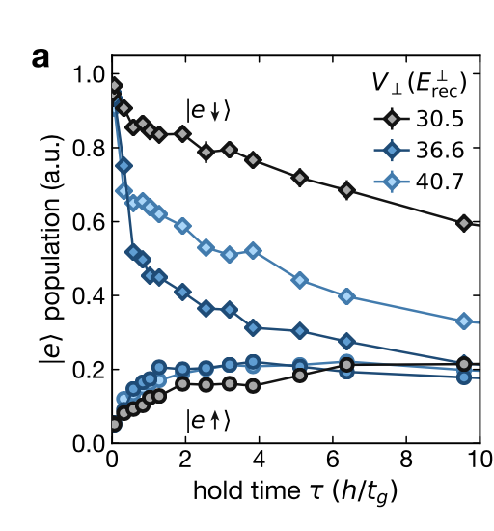
Experiment
Riegger et al ’18 (I. Bloch group)
Ultra cold gases with orbital and spin degrees of freedom allow localized and mobile magnetic moments
e.g. Ytterbium
Two orbitals can be represented in the two lowest-lying states of their electronic spin singlet and triplet manifold,
(denoted |g⟩) and (|e⟩).
Use state-dependent optical lattices

Slide 34
Open quantum systems: Lindbladian (Born-Markov approx) Master equation
Simple derivation
arXiv: 1110.2122
Lindblad equation for density matrix of the system
Markovian environment:
i. Weak coupling to environment (Born approx)
Markov approx:
Env correlation time
total relaxations time
Unitary dynamics
Jump terms
No-jump terms
Rewriting the Lindbladian
Typical system level spacing
Coupling to env
iii. Jump operators time ind.
with

Slide 35
The Kondo Model in dissipative media
The Kondo Hamiltonian, ( describe mobile atoms in gs, metastable atoms in excited state)
With the local impurity spin
Add 2-body loss operators
Nakagawa, Kawakami, Ueda PRL 121, 203001 (2018)
Obtain the Effective Non-Hermitian Hamiltonian (dropping jump operators)
imaginary part is related to the rate of two-body losses due to inelastic scattering.

Slide 36
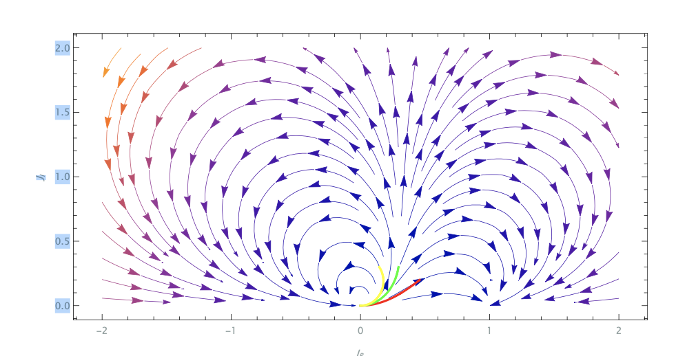
RG in the Non-Hermitian Kondo model
The 2-loop RG eqn:
Indication of a phase transition between:
Trajectories that flow to another fixed point (Kondo phase)
Trajectories that return to the origin (limit cycle)
Cannot identify YSR phase
RG probes small couplings only
No fixed point for YSR, bound state
Nakagawa et al. 2018

Slide 37
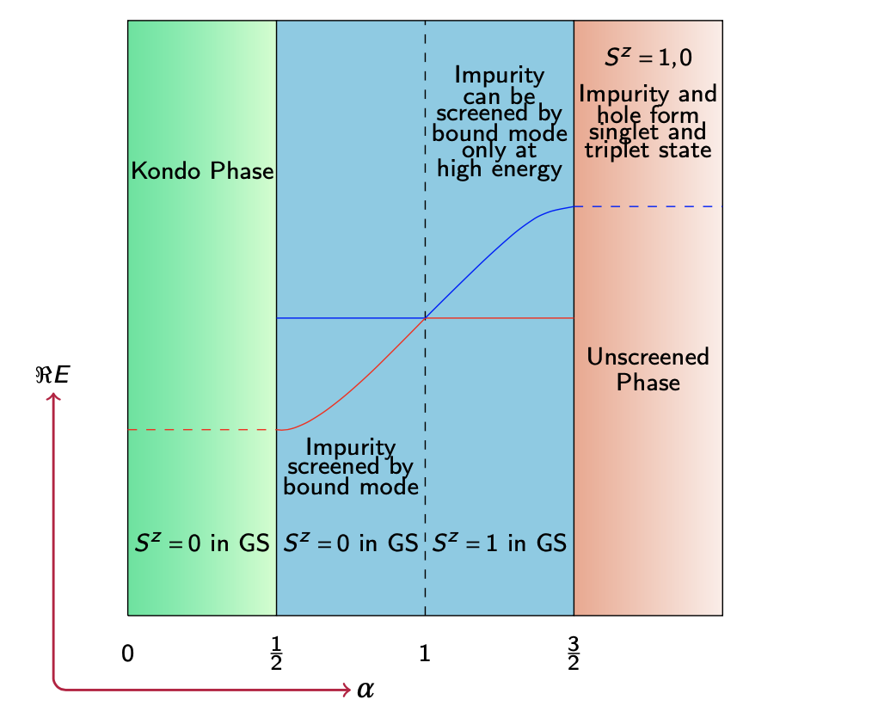
Phase diagram of the Non-Hermitian Kondo model
Diagram similar to the phase diagram
for the Superconductor – Kondo system
- Driving mechanism: electrons lost to Kondo cloud when dissipation is increased

Slide 38
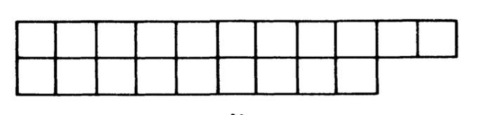
The Bethe Ansatz Equations
Diagonalizing the transfer matrix by means of the Scattering technique, we obtain: (for a state with spins down and spins up)
Is the number of down spins
Solution Expressed in terms of M spin - momenta:
The number of up spins
Number of spins
The total spin
Impurity term: it drives the roots to complex values
Where:
- The phase plays a central role:
it determines the coupling to environment
- For one obtains the Hermitian BA eqns
The allowed momenta

Slide 39
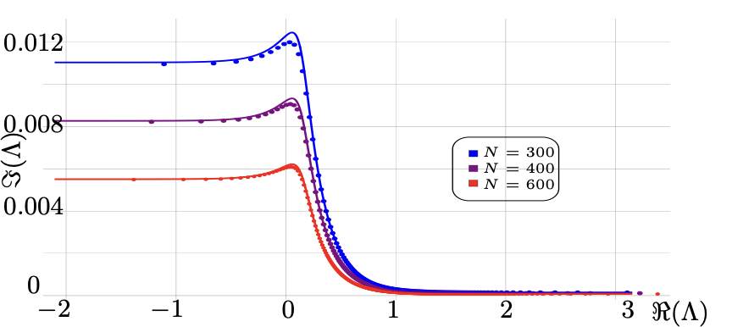
Solutions of the BAE (off the real line)
Impurity term
The impurity term determines the nature of the solutions
For large the roots fall close to the real line to order forming a dense curve :
Numerical solution: the Bethe roots are driven to the real line
We may also have isolated solutions in some parameter region

Slide 40
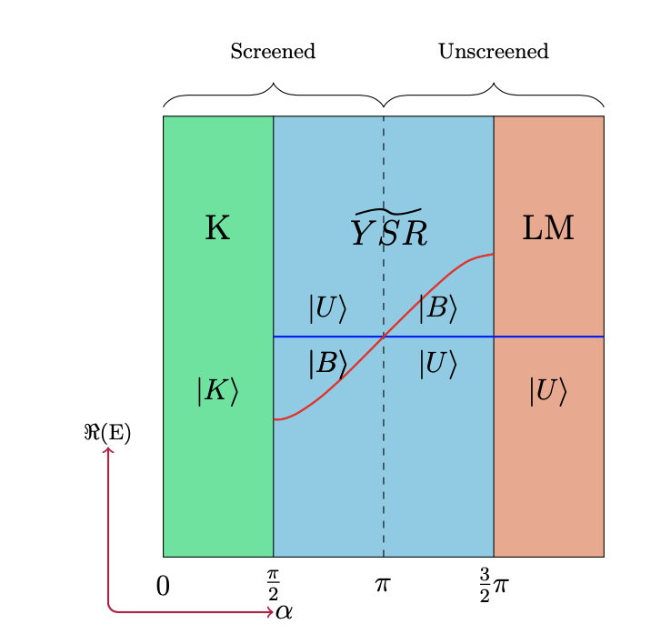
The RG invariant scales and the Phase Diagram
The model is characterized by two RG invariants:
RG scale
Coupling to environment
Equivalently the complex Kondo scale
The parameter determines the phase diagram
In terms of couplings in Hamiltonian

Slide 41
The impurity Term
The impurity term determines the phase diagram of the model
- Becomes the impurity term of the Hermitian model when
- The imaginary part of the denominator changes sign when crosses
The RG invariant determines the phase structure of the model
K denotes the Kondo phase where the impurity is screened by the Kondo cloud in the ground state |K⟩
LM denotes the local moment
phase where the impurity is not completely screened in
the ground state |U ⟩
phase – the impurity is screened by single particle bound mode in |B⟩ state, but is not completely screened in |U ⟩ state.

Slide 42
The Kondo phase
The energy
The ground state energy
decay rate due to two body losses
Excitations: spinons, carry spin ½, no charge, complex energy
Complex DOS
with
Spinon decay rate
where
RG invariants
What is ? Express DOS in term of real energy
Valid for most couplings and energies, But log singularity for
Then to order we have:

Slide 43
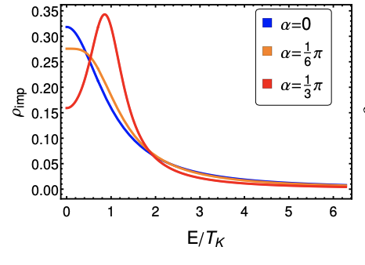
The Kondo phase
We note:
- States with one spinon have a larger lifetime than the Kondo ground state itself,
- it is dynamically advantageous to remove a state from the Kondo cloud
- this lowers the amplitude for a singlet state to be formed at the impurity site, avoiding losses. - But the time scale for such a process being ∝ L, so Kondo state is dynamically stable
The impurity DOS
- As α varies from 0 to π/2, the impurity DOS changes from a pure Kondo behavior at α = 0 with a peak at , to a situation where the peak is shifted to when . Eventually, when the DOS develops a delta peak at
- Therefore, as α increases (so does the bare loss rate ) the number of modes that contribute to the Kondo screening of the impurity decreases until there remains one single mode at when α → π/2.
- We interpret this transfer of spectral weight towards as announcing the apparition of a bound state when

Slide 44
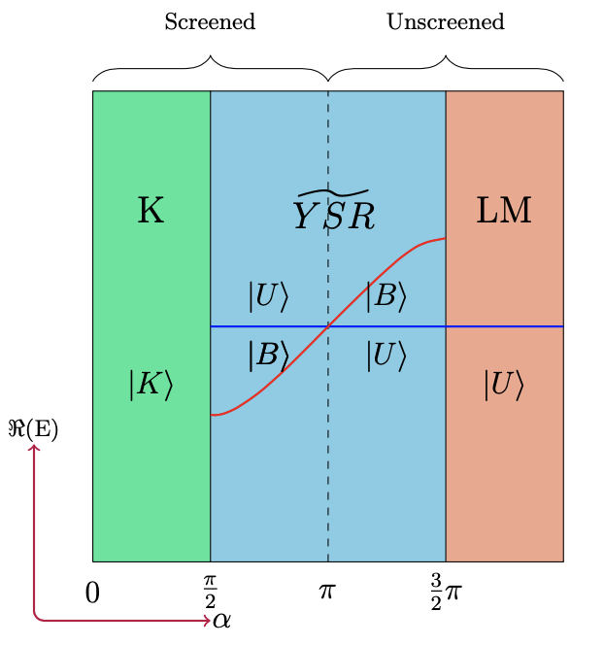
The Bound-Mode phase
A new isolated solution appears in addition to the dense set of solutions of BAE – Impurity String (IS)
The state may be occupied (in addition to ) denote: , or unoccupied, denote
IS energy of the occupied state w.r.t. unoccupied state
where
Occupying the IS state in the range π/2 ≤ α ≤ π lowers the energy leading to a ground state |B⟩, while in the range π ≤ α ≤ 3π/2, not occupying the IS lowers the energy leading to a state |U ⟩
In the state |B⟩ the impurity is screened by a single particle bound mode localized near it, the impurity and the bound mode forms a singlet. (similar to YSR state in a SC)
The bound state energy imaginary part gives the bound state a finite lifetime. Hence, in the phase, even in the regime , the impurity is eventually found to be unscreened at long enough times .
This reflects the fact that the quantum phase transition between the Kondo and unscreened phases is dynamically induced by losses.

Slide 45
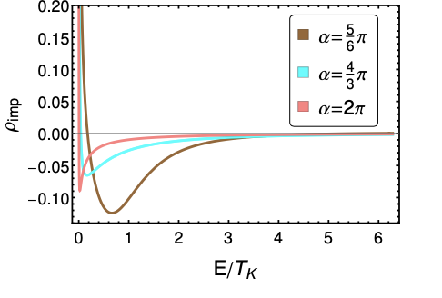
The Bound-Mode phase
The state
- The root density
The number of solutions (Here choose even. If odd need add hole)
- Spin of state impurity unscreened
- The ground state energy
- The spinon DOS as a function of real we find
where and
- We observe that the contribution of the spinons to the DOS can be positive as well as negative depending on the energy. We conjecture that the positive contribution corresponds to a partial screening of the impurity and negative contribution of the as the signature that spinons do not participate to the screening of the impurity

Slide 46
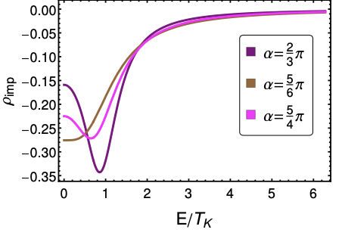
The Bound-Mode phase
The state
- The continuous root density and ground state energy are analytic continuations of the Kondo phase to region
- The spinon DOS
- is the analytic continuation to
- The delta function contribution comes from the bound state.
- The impurity contribution to the spinon DOS is always negative. However, due to
the positive delta function contribution the integrated density of state is positive and equals to ½ as in the Kondo phase.
- We interpret the negative contribution of the spinons as the signature that they do
not participate to the screening of the impurity in the |B⟩ state, only the bound state does.

Slide 47
The Local Moment Regime
- For there is no single particle bound state
the impurity can not be completely screened.
- For even, the total spin of the ground state is S=1/2 and it is described by the analytical continuation of to values of
- The ground state root distribution and the density of states are given as before. The impurity is partially screened by the positive part of DOS.

Slide 48
Dissipation driven phase transition
We saw
so bound state energy is negative for α ≤ π and positive for α ≥ π.
On the basis of purely energetic considerations, the impurity is screened (resp. unscreened) in the region α ≤ π (resp. α ≥ π) with a first order phase transition at α = π where the two states cross.
However, since even when α ≤ π, the impurity is eventually found unscreened at sufficiently large time .
Consider preparing the state of the system at time t = 0 in a linear combination of the unscreened and screened states . After some time t (including losses)
So that whenever after a time the system will be in the unscreened state |U ⟩.

Slide 49
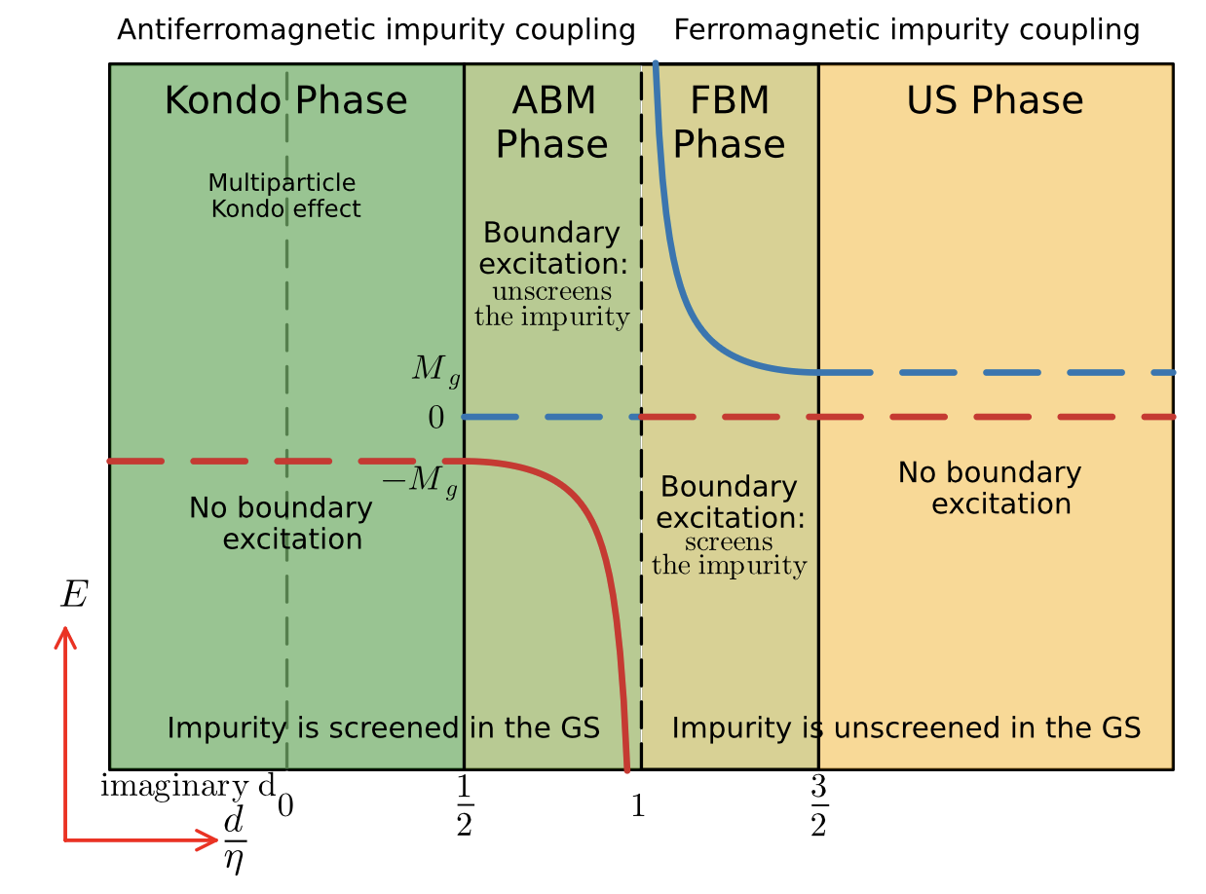
Kondo impurity in a spin chain: PT – invariant
Kondo
YSR
Local Moment
Y Wang ’98, H Frahm, A Zvyagin ‘98
PT- symmetry:
- energy eigenvalues are real (PT symmetric phase)
- energy eigenvalues occur in complex conjugate pair (PT symmetry spontaneously broken)

Slide 50
Conclusions
The Superconductor-Kondo system
A renormalzed Kondo regime ( J flows to strong coupling)
A renormalized moment regime ( J flows back to weak coupling)
YSR states are mostly destroyed by quantum fluctuations
Facilitates 1st order QPT – semiclassical description (a bound state forms, no RG description)
Similar phase diagrams
- The non-Hermitian Kondo model
- The PT- invariant XXX-Kondo spin chain
Driving mechanisms: Fluctuations and dissipation

