Slide 1


Institute of Physics, CAS
Topological quantum integrability
Yupeng Wang
Hangzhou
2024. 11. 01

Slide 2
Outline
Ⅰ
Topological integrable boundary
Ⅱ
Exact solution of topological spin chain
Ⅲ
Eigenstates
Ⅳ
Exact spectrum: ground state and elementary excitations
Ⅴ
Summary

Slide 3
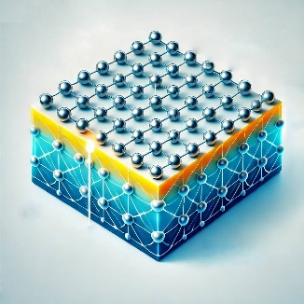
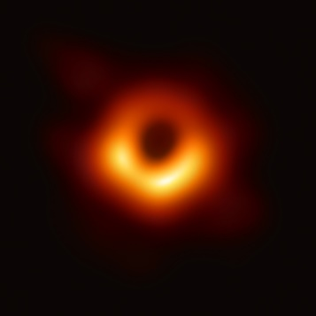
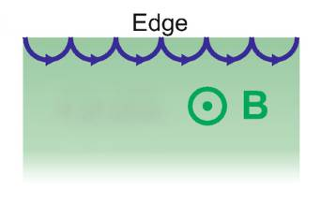
Ⅰ
Topological integrable boundary
An important issue in physics: boundaries!
2-d boundaries
0-d boundaries
L
0
1
Impurities (Kondo problem)
L-1
L
1
2
Surface and interface (TI)
1-d boundaries
Open strings
Black holes
L-1
L
1
2
Edge states in quantum Hall effect
Source and drain
Quantization in compact topological manifold

Slide 4
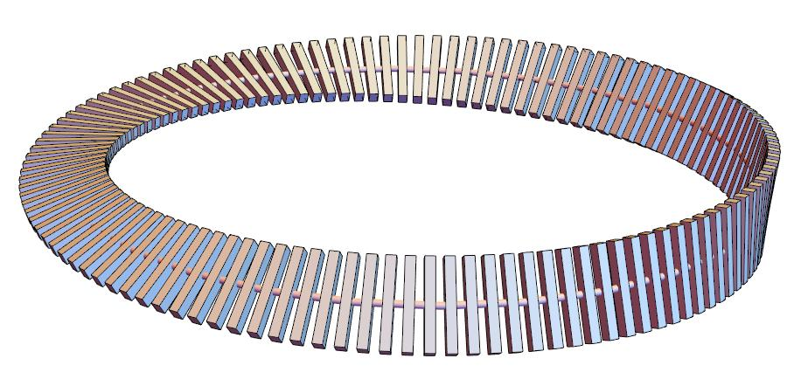
Ⅰ
Topological integrable boundary
Topologically, 0-d boundaries can be identified as
Case A: Compact
Spin ring
Case B: Open
Spin chain
Such kind of problems need exact solutions!
Leave the task to mathematical physics!

Slide 5


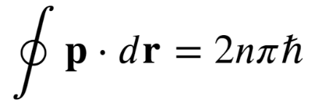
Ⅰ
Topological integrable boundary
Heisenberg algebra
Bohr-Sommerfeld quantization condition
How to quantize in topological space?
Our exact quantization procedure includes:
the nature of the vacuum (ground state) within a topological manifold
the types of particles (elementary excitations) that may emerge
how these particles interact with and exist within the topological manifold
Start point: integrable models with topological boundary condition

Slide 6

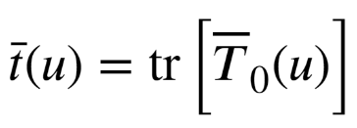



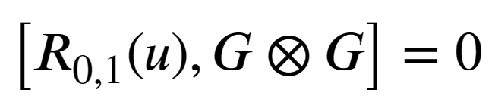



Ⅰ
Topological integrable boundary
Yang-Baxter equation
R matrix
Monodromy matrix
Transfer matrix
YBE
RTT relation
Integrable conserved quantity
Integrable transfer matrix

Slide 7
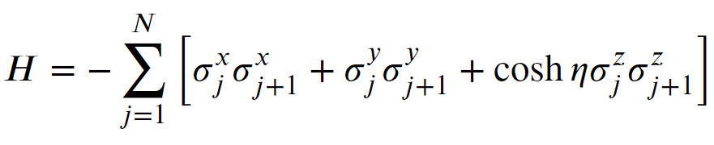

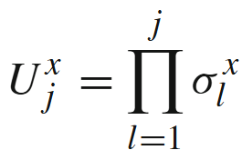
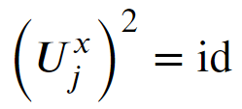
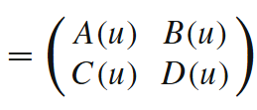



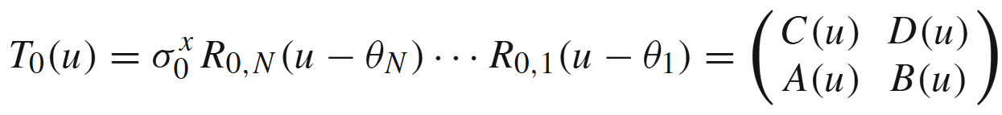

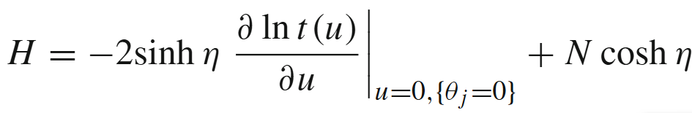
Ⅰ
Topological integrable boundary
The XXZ spin torus Hamiltonian is
with the anti-periodic boundary condition:
Integrability
symmetry
Inhomogeneous parameters $θ_{j}$ are introduced for convenience!
Batchelor et al

Slide 8




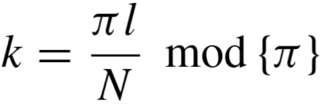
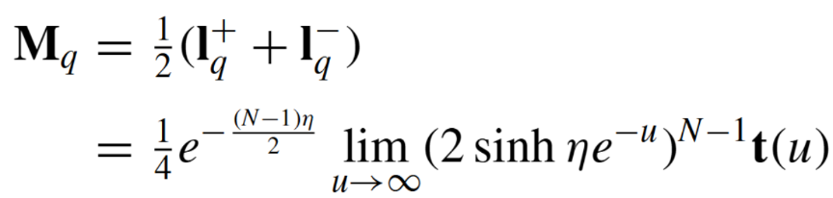
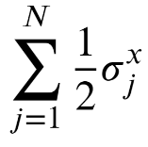

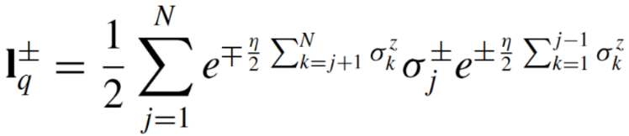
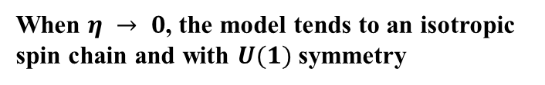
Ⅰ
Topological integrable boundary
Basic properties of the transfer matrix
Topological momentum
Eigenvalue
String charge
When $η → 0$, the model tends to an isotropic spin chain and with $U(1)$symmetry
Generators of quantum group

Slide 9
1
Topological integrable boundary
Ⅱ
Exact solution of topological spin chain
3
Eigenstates
4
Exact spectrum: ground state and elementary excitations
5
Summary

Slide 10
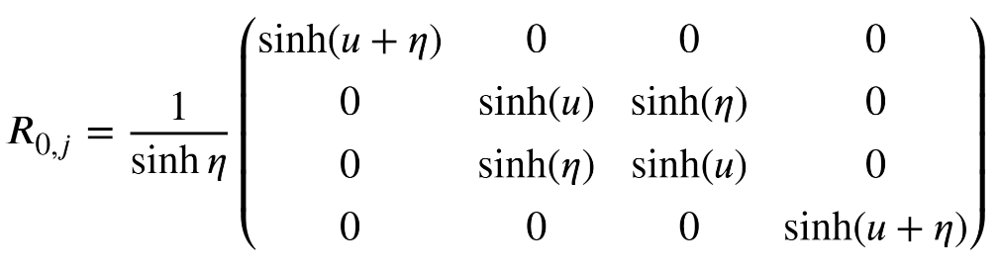

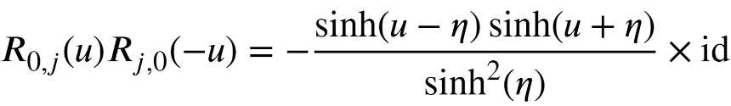

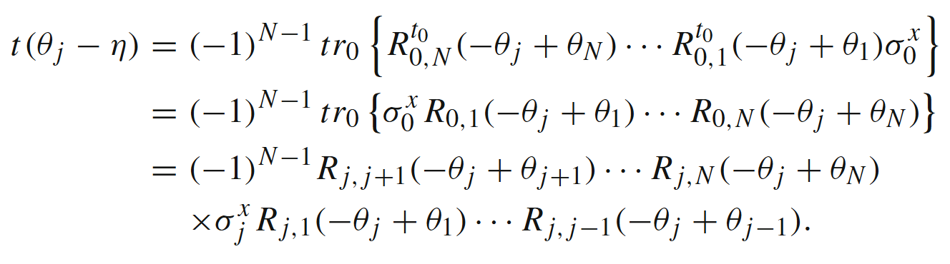
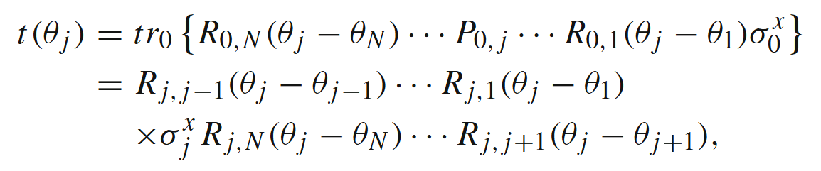
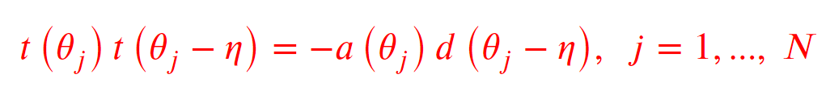
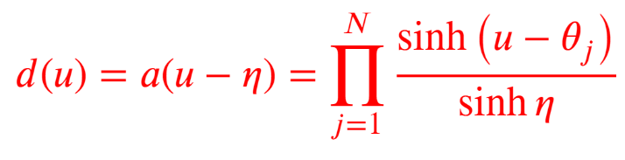

Ⅱ
Exact solution of topological spin chain
Operator Identity
J. Cao, W.-L. Yang, K. Shi and Y. Wang,
Phys. Rev. Lett. 111, 137201 (2013)
R-matrix
Initial condition:
Unitary relation:
Crossing relation:
Consider particular points $u=θ_{j}$ and $u=θ_{j}−η$
Quantum determinant

Slide 11

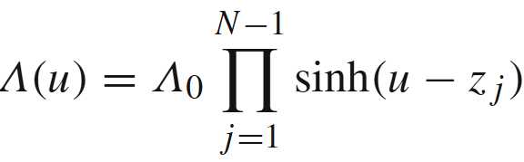
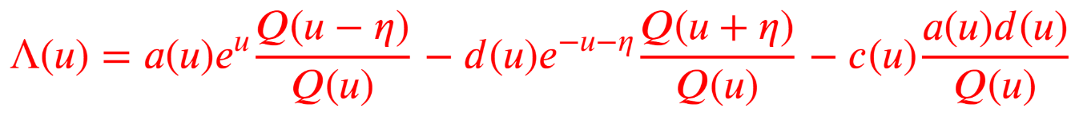
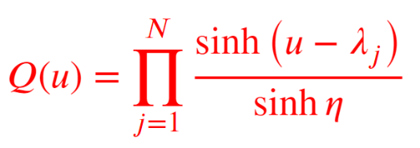

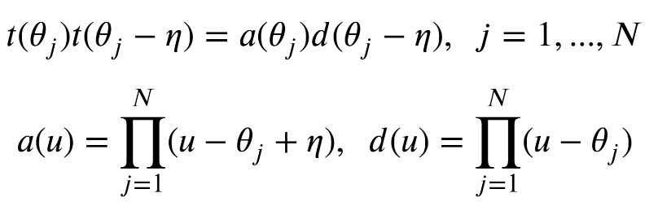
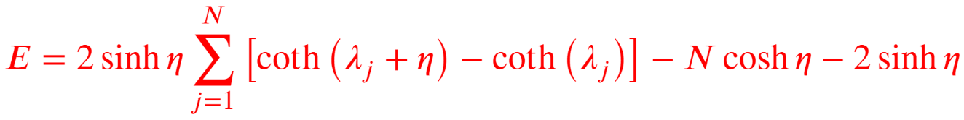


Ⅱ
Exact solution of topological spin chain
Solving the spectrum via ODBA method
$N$constraints
$Λ_{0}$ is a constant
Inhomogeneous T-Q relation
CYSW term
Notice
Regularity of $Λ(u)$ gives
Eigenvalue of Hamiltonian

Slide 12
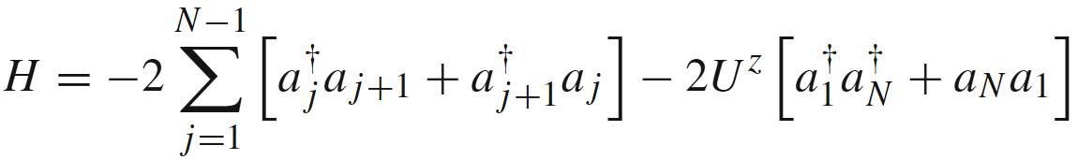

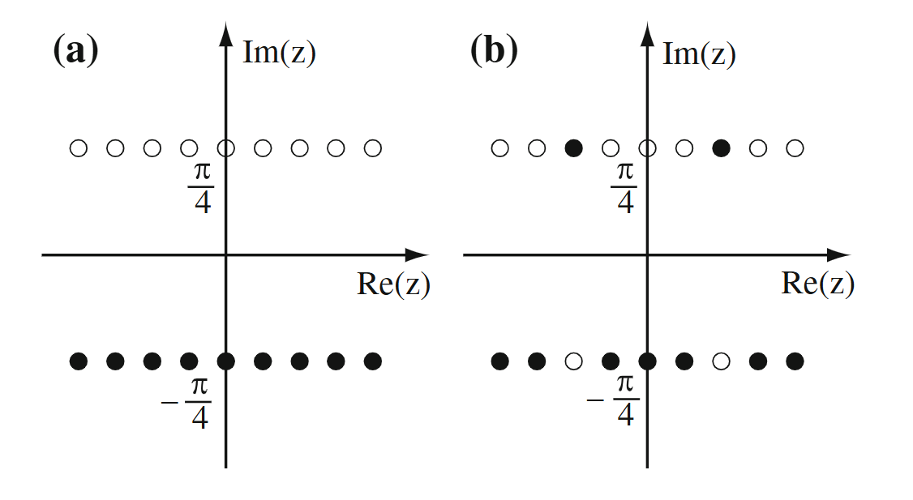
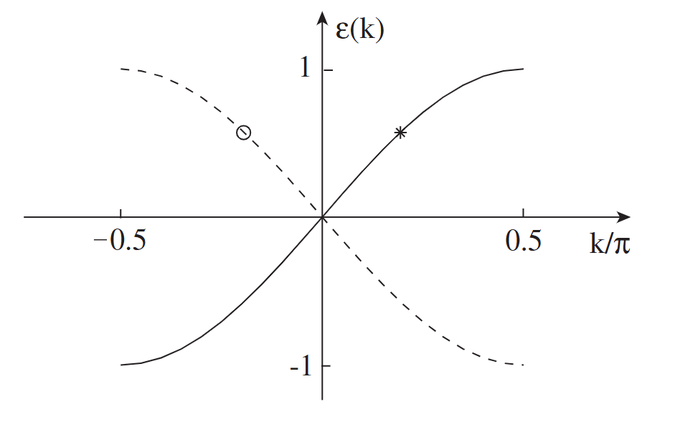

Ⅱ
Exact solution of topological spin chain
Free fermion case
Considering $η=\frac{i π}{2}$
J-W
A superconducting quantum dot embedded in a metallic ring
Topological confiment of spinons!
Propagating Majorana fermions!

Slide 13
1
Topological integrable boundary
2
Exact solution of topological spin chain
Ⅲ
Eigenstates
4
Exact spectrum: ground state and elementary excitation
5
Concluding remarks & perspective

Slide 14








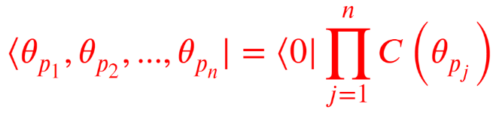
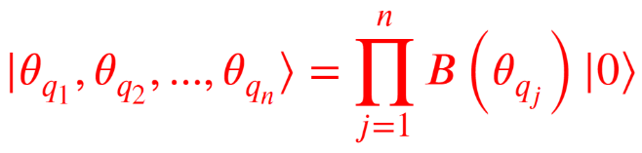


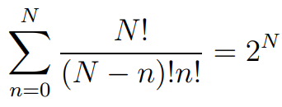
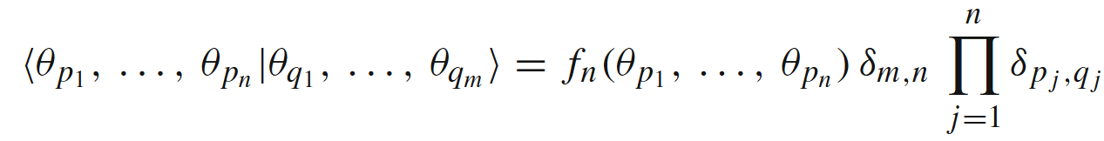
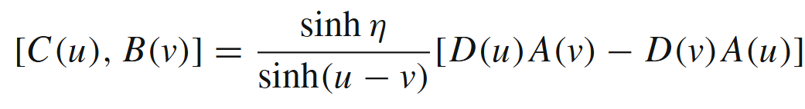

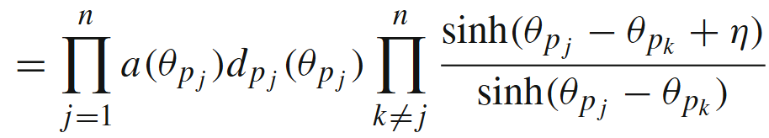

Ⅲ
Eigenstates
The quantum separation of variables (SoV) method
X. Zhang et al., J. Stat. Mech. 2015, P05014 (2015).
Define all spins up state:
An orthogonal SoV basis:
From ABA, the commutation relations are
Total number

Slide 15
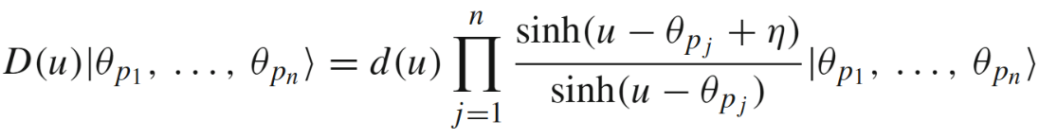
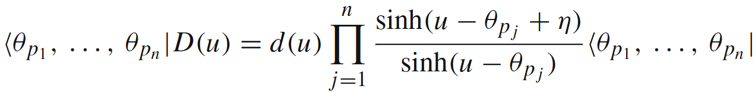
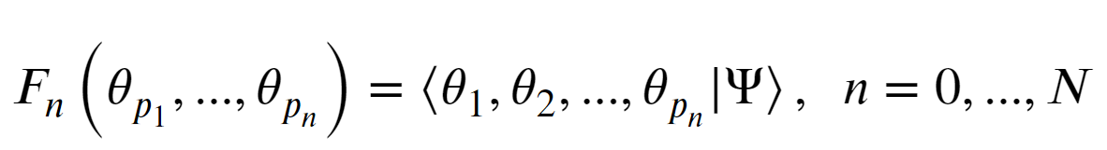
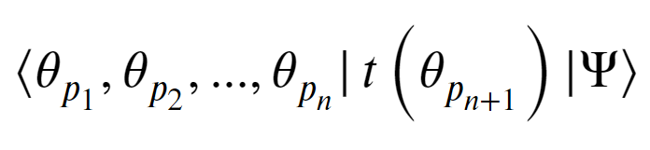
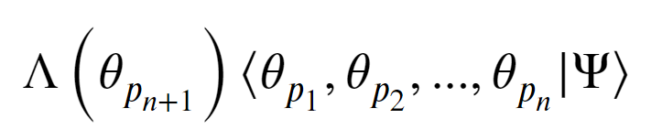
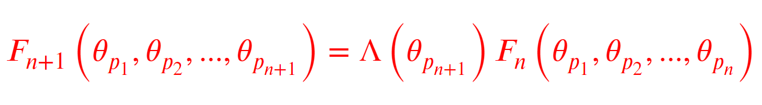
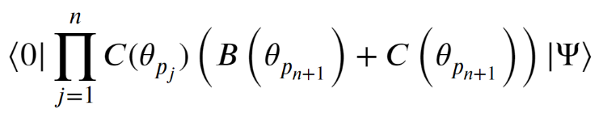
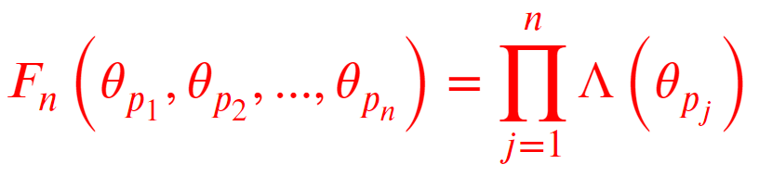

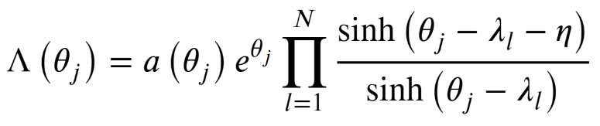
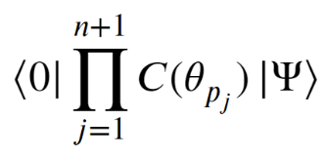
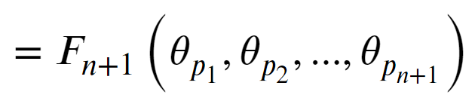

Ⅲ
Eigenstates
This basis is the eigenstates of $D(u)$
Scalar product
Eigenstate of Hamiltonian
Identity

Slide 16
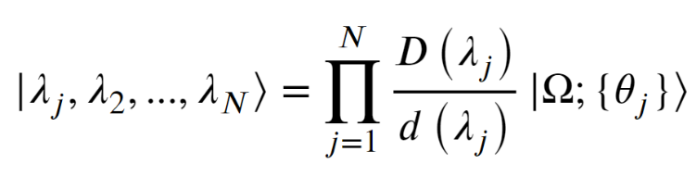









Ⅲ
Eigenstates
Ansatz
A $q$-spin coherent state!

Slide 17
1
Topological integrable boundary
2
Exact solution of topological spin chain
3
Eigenstates
Ⅳ
Exact spectrum: ground state and elementary excitations
5
Summary

Slide 18







Ⅳ
Exact spectrum: ground state and elementary excitations
Inhomogeneous BAEs leads to disordered Bethe roots patterns!
We propose two methods: T-W method and T-$θ$ method
T-W method
$z_{l}$s, $w_{l}$s are zeros of$Λ\left(u\right)$ and $W\left(u\right)$
T-W BAEs:
Homogeneous BAEs give nice Bethe roots pattern!

Slide 19

Ⅳ
Exact spectrum: ground state and elementary excitations
$T−θ$ Method
A convenient method to compute physical quantities
Substituting
into
gives another homogeneous $T−θ$ BAEs of $θ$ and $z$ roots.
We can use $T−θ$ BAEs to get the ground state energy and elementary excitations by
Step 1:
Determining $z$ root pattern of ground state and excited state.
Step 2:
Taking logarithm of $T−θ$ BAEs to get Integral equations of density of 𝜃 $σ(θ)$and density of 𝑧 $ρ(z)$ in the thermodynamic limit.
Auxiliary density of inhomogeneity
Step 3:
Taking $σ\left(θ\right)→δ\left(θ\right)$ and solving $ρ(z)$ density function.

Slide 20










Ⅳ
Exact spectrum: ground state and elementary excitations
$T−θ$ Method
Y. Qiao et al., Phys. Rev. B 102, 085115 (2020)
X. Le et al., JHEP 11, 044 (2021)
Parameterization:
$z_{j}−\frac{η}{2} (j=1,…,N−1)$ are zeros of $Λ\left(u\right)$
The homogeneous $t−θ$ BAEs
Eigenvalue
Calculating eigenvalues and elementary excitations requires determining the patterns of z roots!

Slide 21











Ⅳ
Exact spectrum: ground state and elementary excitations
The structure of Bethe roots
considering $η>0$
$z_{j} −\frac{η}{2}$and $iu_{j} −\frac{η}{2}$ are undistinguishable for $Λ\left(u\right)Q(u)$
$z_{j}$ are symmetric about the imaginary axis $→$ $u_{j}$ are symmetric about the real axis
The Bethe roots form strings in the thermodynamic limit

Slide 22










Ⅳ
Exact spectrum: ground state and elementary excitations
The structure of z roots
Similar analysis gives
zero roots are symmetric about the real axis
In the thermodynamic limit, $z$ root satisfies
Ground state z root diagram with $N=9$
Blue stars: $\{θ_{j}=0\}$, red circles: {$θ_{j}=0.14i, 0.32i, −0.43i, 0.54i, −0.25i, 0.63i, 0.47i, −0.78i, 0.19i$}

Slide 23

















Ⅳ
Exact spectrum: ground state and elementary excitations
:ground state energy
Taking the logarithm of the absolute value of $t−θ$ BAEs:
In the thermodynamic limit $N → ∞$
is the density of
is the density of
The homogeneous limit $\{θ_{j} = 0\}$ corresponds to $σ(z) = δ(z)$
Using Fourier transformation and normalization
The energy at ground state

Slide 24








Ⅳ
Exact spectrum: ground state and elementary excitations
:elementary excitations
The simplest elementary excitation: $z_{N−2}^{′}$ and $z_{N−1}^{′}$form a conjugate pair and all the other roots remain real.
$z_{l}^{′}$, $α$ are real and $n≥2$
The energy at this excited state
Elementary excitation energy
The excited state $z$ root diagram with $N=10$

Slide 25














Ⅳ
Exact spectrum and excitation
:even $N$ case energy and elementary excitations
$η_{+}$ is real
Root pattern
At the ground state $β = 0$, at the excited state $β≠ 0$.
Energy
Density of $z_{l}^{′}$
$z$ root diagram with $N=10$
Excited state energy
Ground state energy
$$β→0$$
gives $ΔE_{2}→0$

Slide 26










Ⅳ
Exact spectrum: ground state and elementary excitations
:odd $N$ case energy and elementary excitations
$$N=9$$
$η=0.75+i π$
Ground state Bethe root pattern
Ground state energy
Root pattern
Ground state
Excited state energy
A low-lying excited state

Slide 27







Ⅳ
Exact spectrum: ground state and elementary excitations
:odd $N$ case dispersion relation
$t(0)$ is a conserved quantity and can be treated as a shift operator in the $Z_{2}$topological manifold
Topological momentum operator
In the thermodynamic limit
The total topological momentum

Slide 28
1
Topological integrable boundary
2
Exact solution of topological spin chain
3
Eigenstate construction
4
Exact spectrum and excitation
Ⅴ
Summary

Slide 29

Ⅴ
Summary
We present a systematic and universal framework to exactly solve topological quantum integrable models:
Exact solutions via off-diagonal Bethe ansatz
Eigenstate via the quantum separation of variables
Ground state spectrum and excitations via T-W and T-$θ$ methods

Slide 30

Collaborators :
J. Cao, W.L. Yang, K. Shi, G. Li, X. Zhang, Y. Qiao, Y.Y. Li , S. Cui, P. Sun
Thank you

